Slide 1
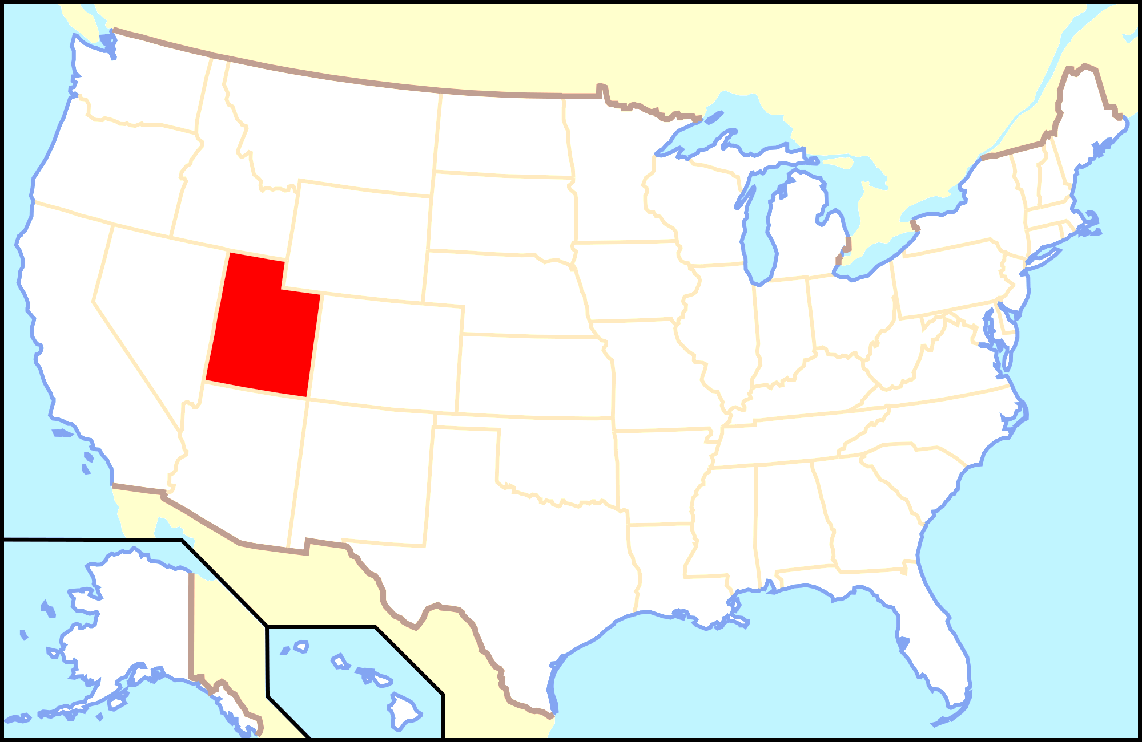
Dreaming of
a Faith-Based
Senior Living Community
in Ogden, Utah
*
Ogden

Slide 2
LDS
63%

Slide 3
What happens to UMs?
Shirley
Ann

Slide 4
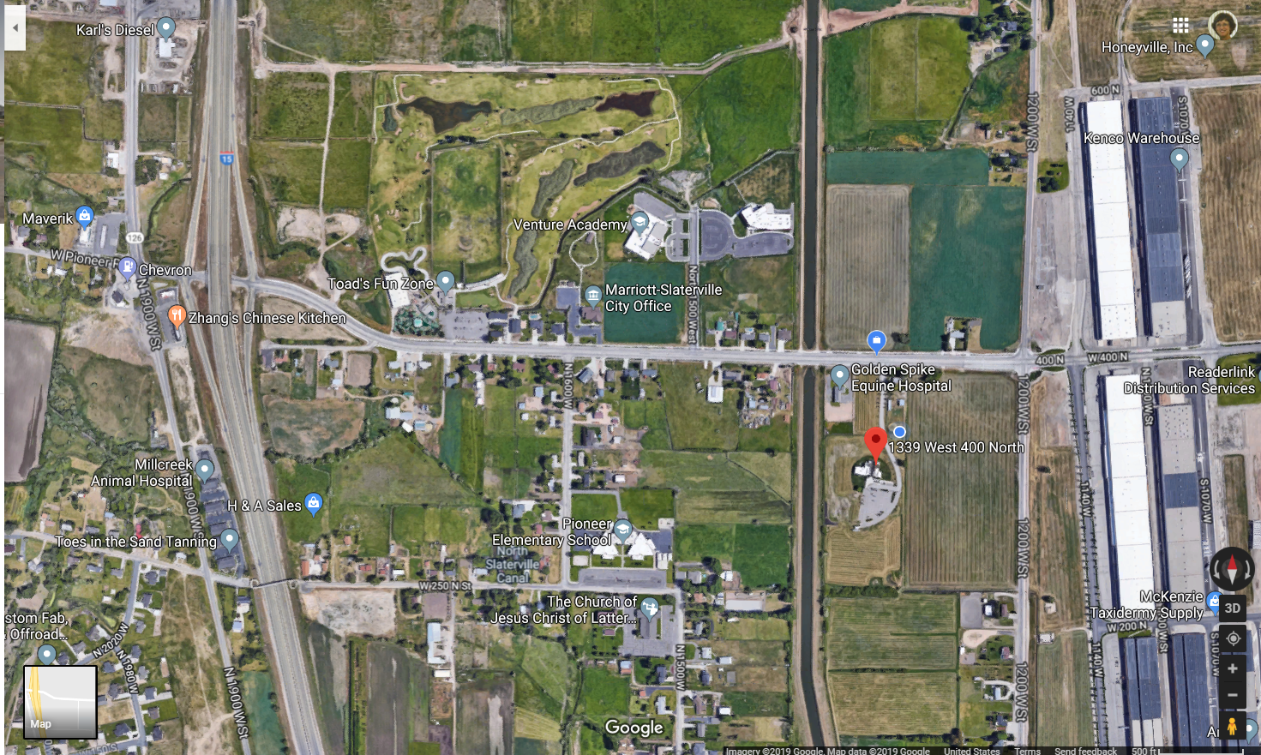
Future Hospital
Industrial Park
First UMC

Slide 5
Industrial Park
First UMC

Slide 6
QUESTIONS:
Can we develop a faith-based senior living community that meets needs of individuals and improves FUMC’s ministry?

Slide 7
QUESTIONS:
2. What kind of senior living community is best to meet spiritual, social, physical, financial needs? Indep Houses with Com. Ctr., Asstd/Mem Care, Continuum of Care, etc.

Slide 8
QUESTIONS:
How to create and maintain
a strong faith-based identity
and population?

Slide 9
LDS
63%

Slide 10
QUESTIONS:
4. How can my church afford to do this?
Market/Feasibility Study
Construction
Management $$$

Slide 11
PROGRESS TO DATE:
Visited Retirement Communities
of NJ—Sept. 2017
Duke Reflective Leadership Grant
$15,000 for time & research
Jan 2019-June 2020

Slide 12
PROGRESS TO DATE: Utah
Jan—Weber County Director of
Aging Services
Feb—Summit Vista Senior Living
Community in Taylorsville
Feb—Architect/Entrepreneur for
“Building God’s Way”

Slide 13
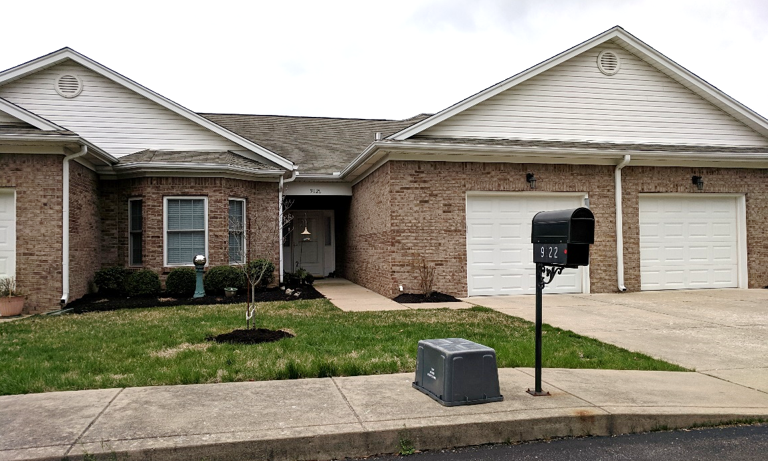
PROGRESS TO DATE: March Louisville, KY—Wesley Manor
Jerry Hoganson, Pres.

Slide 14
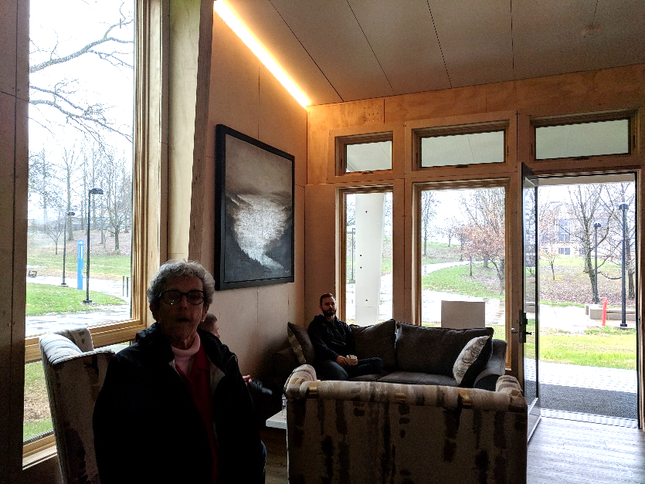
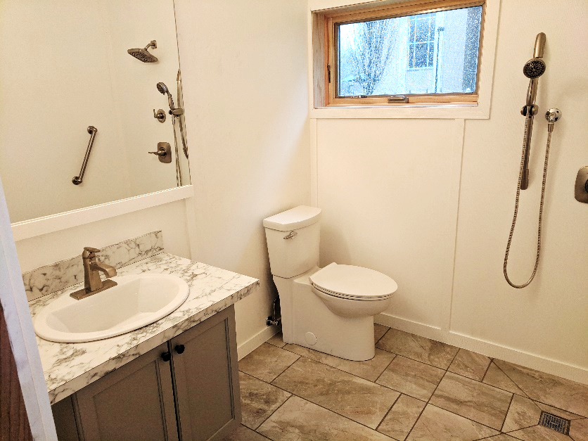
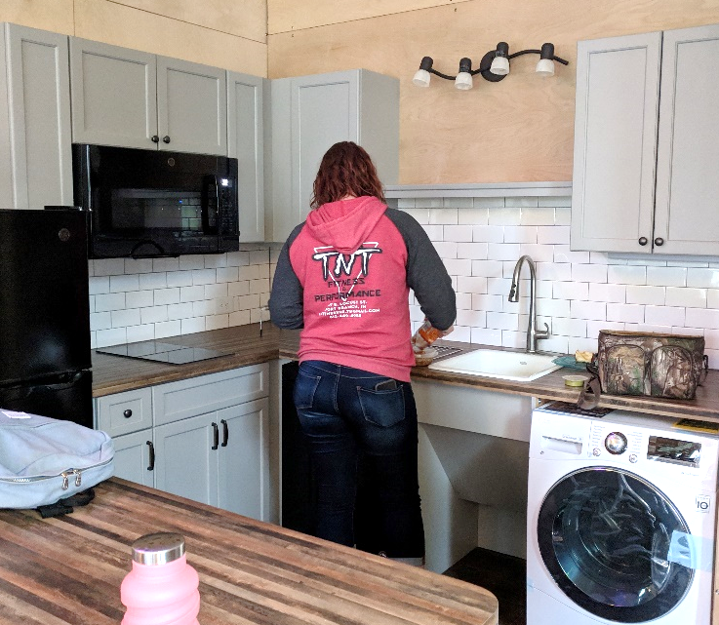
PROGRESS TO DATE: March
Univ. S. Indiana—Minka House
(also Loveland, CO)

Slide 15
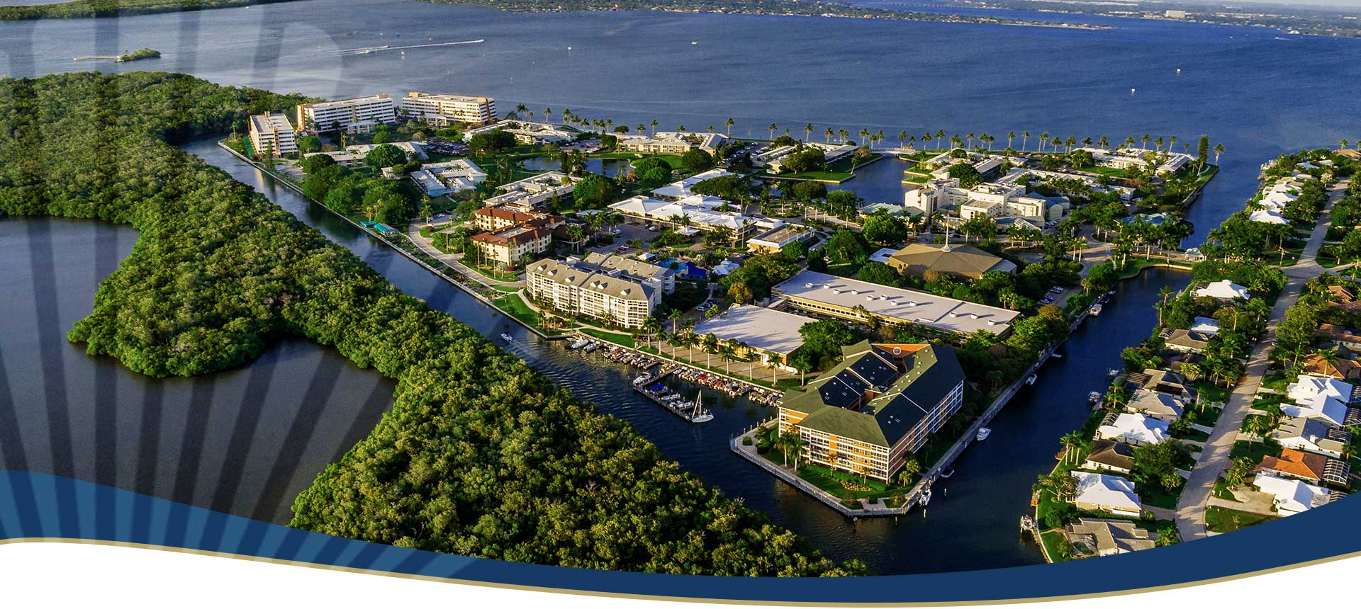
PROGRESS TO DATE:
May--UMA at Shell Point, Ft Myers

Slide 16
PROGRESS: July
Trip with 81-year old Mother
Kalispell, MT:
Immanuel Lutheran
Communities
The Woodlands

Slide 17
PROGRESS: July
Trip with 81-year old Mother
Great Falls, MT:
Benefis Systems
Grandview

Slide 18
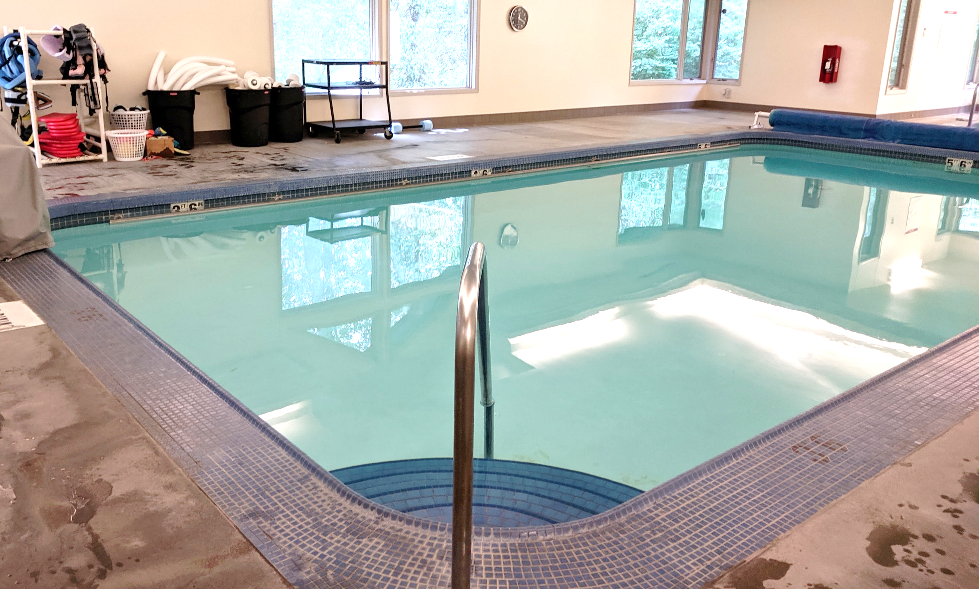
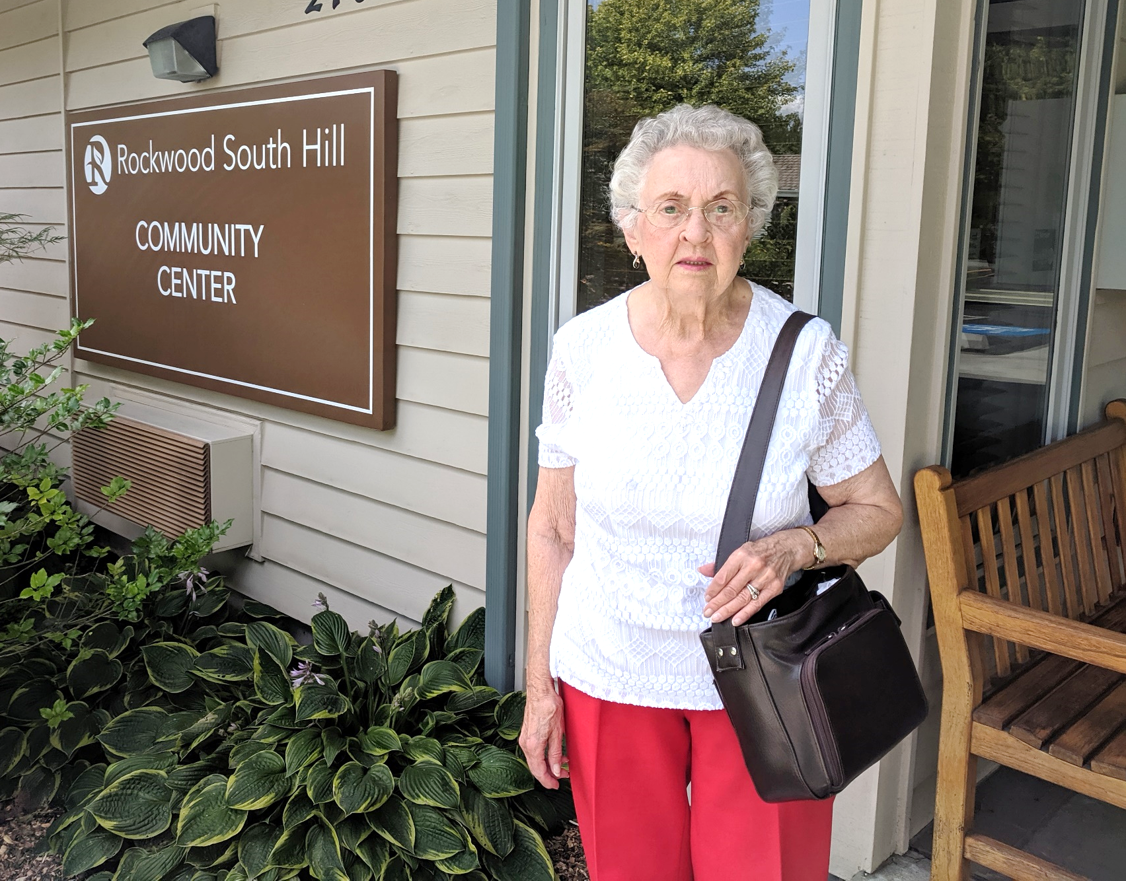
PROGRESS: July
Trip with 81-year old Mother
Spokane, WA:
Rockwood Homes
(aka UM Homes of Spokane)

Slide 19
PROGRESS: August 5-9
Nashville—UM Discipleship
Ministries

Slide 20
PROGRESS: August 10 Conversations
at Trinity Presbyterian Church

Slide 21
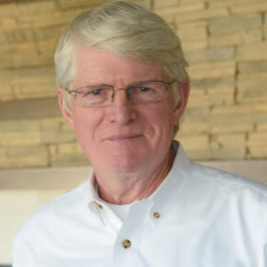
PROGRESS: August 11
Meeting at FUMC
with David Slack of
Frasier Retirement
Communities--
Boulder, CO
+ 10 of you!

Slide 22
No decisions have been
made yet. At this
stage, we are just
doing research
and gaining ideas.

Slide 23
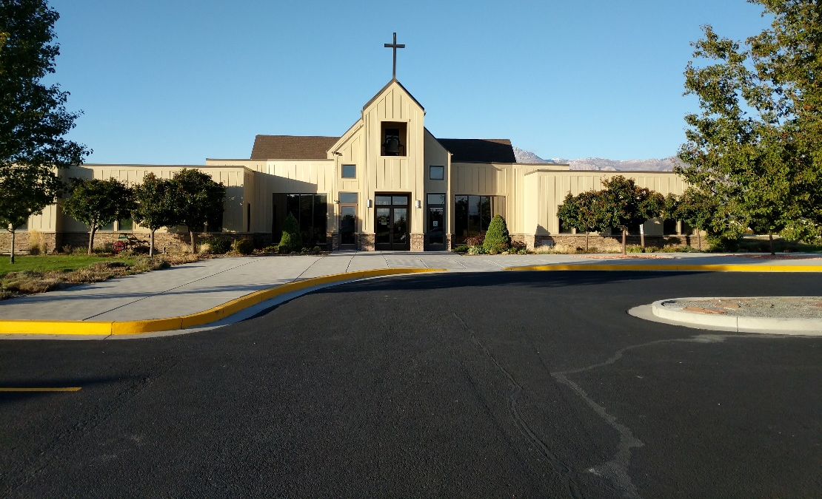
PROGRESS: August 20
FUMC Board of Trustees
recommended that FUMC create a separate non-profit
corporation to explore
beneficial land use.

Slide 24
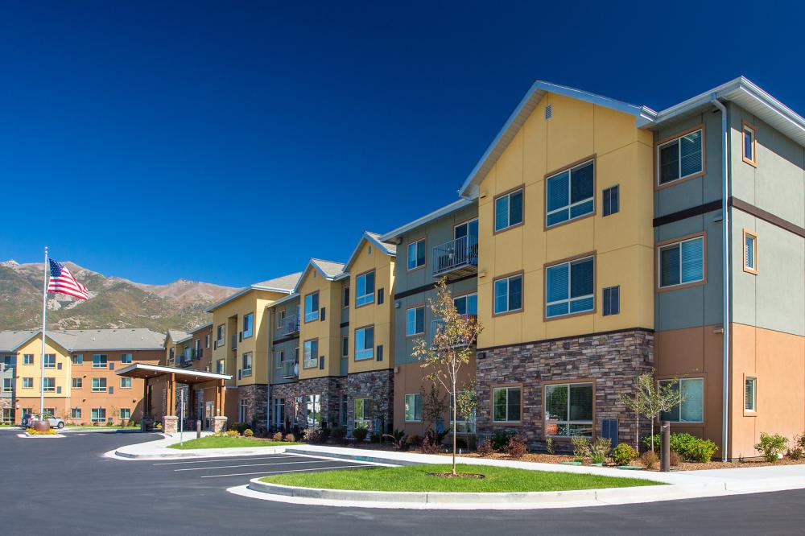
PROGRESS: Aug 22
Treeo in S. Ogden
w/ Betty C.

Slide 25
PROGRESS: August
Referrals from New Church Attendees
Carol Campbell^{2–} Sabetha, KS Apostolic Christian Retirement Community
Aaron Rivers—Weathervane Project in Vermont

Slide 26
PROGRESS Scheduled:
Oct. 26-30 Trip to San Diego
Leading Age Conference

Slide 27
PROGRESS to be Planned:
Local conversations with
Marriott-Slaterville Planning
Legal authorities

Slide 28
PROGRESS to be Planned:
More Local visits to
N. Ogden—w/ Meckleys
Brigham City—w/ Dubenezics

Slide 29
Conversations with YOU
What are your hopes (and fears) for FUMC ministry?
What are your hopes (and fears) for your own aging?
What is affordable senior housing?

Slide 30
HOW YOU CAN HELP
Would you like to go with me?
What questions are on your mind?
Are you interested in doing any R&D on this?
Would you like to be on a Team?
PROGRESS TO DATE:
Aug—Certificate in Religious Fundraising

Slide 31
HOW YOU CAN HELP
Market/Feasibility Study $$$
Architectural Plans $$$$$$$$
Stay Tuned! Stay Positive!
PROGRESS TO DATE:
Aug—Certificate in Religious Fundraising

