Slide 1
Pinecliff Camp
and Retreat Center
Notes:
Animated floating petals
(Difficult)
Tip: For best results with the animation effects on this slide, choose a picture with an object that is made up of multiple parts, like the flower in this example.
To reproduce the background effects on this slide, do the following:
On the Home tab, in the Slides group, click Layout, and then click Blank.
Right-click the slide and then click Format Background.
In the Format Background dialog box, click Fill in the left pane. In the Fill pane, select Picture or texture fill, and then under Insert from, click File.
In the Insert Picture dialog box, select a picture, and then click Insert.
On the Insert tab, in the Illustrations group, click Shapes, and then under Rectangles, click Rectangle (first option from the left). On the slide, drag to draw a rectangle.
Select the rectangle. Under Drawing Tools, on the Format tab, in the Size group, do the following:
In the Shape Height box, enter 7.5”.
In the Shape Width box, enter 10”.
On the Home tab, in the Drawing group, click the arrow next to Shape Outline, and then click No Outline.
On the Home tab, in the Drawing group, click the arrow next to Shape Fill, point to Gradient, and then click More Gradients.
In the Format Shape dialog box, click Fill in the left pane. In the Fill pane, select Gradient fill, and then do the following:
In the Type list, select Radial.
Click the button next to Direction, and then click From Center (third option from the left).
Under Gradient stops, click Add gradient stops or Remove gradient stops until two stops appear in the drop-down list.
Also under Gradient stops, customize the gradient stops that you added as follows:
Select the first stop in the slider, and then do the following:
In the Position box, enter 0%.
Click the button next to Color, and then under Theme Colors click Black, Text 1, Lighter 5% (sixth row, second option from the left).
In the Transparency box, enter 40%.
Select the last stop in the slider, and then do the following:
In the Position box, enter 100%.
Click the button next to Color, and then under Theme Colors click Black, Text 1, Lighter 5% (sixth row, second option from the left).
In the Transparency box, enter 10%.
Select the rectangle. On the Home tab, in the Drawing group, click Arrange, point to Align, and then do the following:
Click Align Middle.
Click Align Center.
To reproduce the shape effects on this slide, do the following:
On the Insert tab, in the Illustrations group, click Shapes, and then under Lines, click Freeform (11th option from the left).
On the slide, click points to trace an outline around a shape on the background picture (in the example above, one of the flower petals).
Right-click the freeform shape and click Edit Points. To make the freeform shape more similar to the shape on the picture, right-click a place to include another point, and click Add Points. Drag the new point to follow the contour of the shape on the picture. To outline rounded edges of the shape on the picture, right-click a straight line segment, and click Curved Segment.
Select the freeform shape. On the Home tab, in the bottom right corner of the Drawing group, click the Format Shape dialog box launcher. In the Format Shape dialog box, click Line Color in the left pane, and then in the Line Color pane, select No line.
Also in the Format Shape dialog box, click Fill in the left pane, and then in the Fill pane, select Slide background fill.
Repeat the process in steps 1-5 to create six full-color shapes on the slide (in the example above, six flower petals from the same flower).
To reproduce the animation effects on this slide, do the following:
On the slide, select the rectangle. On the Animations tab, in the Advanced Animation group, click Add Animation, and then under Entrance click Fade.
Also on the Animations tab, in the Timing group, do the following:
In the Start list, select After Previous.
In the Duration box, enter 2.00 seconds.
On the slide, select one of the freeform shapes. On the Animations tab, in the Advanced Animation group, click Add Animation, and then under Emphasis click Spin.
Also on the Animations tab, in the Timing group, do the following:
In the Start list, select With Previous.
In the Duration box, enter 2.00 seconds.
On the Animations tab, in the Advanced Animation group, click Add Animation, and then under Emphasis click Grow/Shrink.
Also on the Animations tab, in the Timing group, do the following:
In the Start list, select With Previous.
In the Duration box, enter 2.00 seconds.
On the Animations tab, in the Advanced Animation group, click Add Animation, and then click More Motion Paths. In the Add Motion Path dialog box, under Lines & Curves, click S Curve 1.
Also on the Animations tab, in the Timing group, do the following:
In the Start list, select With Previous.
In the Duration box, enter 2.00 seconds.
On the slide, select the S curve motion path. Point to the endpoint (red arrow) of the selected right motion path until the cursor becomes a two-headed arrow. Drag the endpoint off the right side of the slide.
Right-click the motion path and select Edit Points, and then do the following:
Right-click the middle point in the motion path animation and select Smooth Point.
Click the middle point. Drag one of the blue sizing lines until the curve in the motion path is smooth.
On the slide, select the animated freeform shape. On the Animations tab, in the Advanced Animation group, click Animation Painter, and then click one of the other freeform shapes. Repeat this process for each of the remaining freeform shapes.
Also on the Animations tab, in the Advanced Animation group, click Animation Pane. In the Animation Pane, do the following to edit the animation effects:
Select the second animation (first freeform shape spin effect). On the Animations tab, in the Animation group, click the Effect Options dialog box launcher. In the Spin dialog box, do the following:
On the Effect tab, in the Amount list, in the Custom box, enter 360⁰, and then press ENTER. Also in the Amount list, click Counterclockwise.
On the Timing tab, in the Start list, select After Previous.
Select the third animation (first freeform shape grow/shrink effect). On the Animations tab, in the Animation group, click the Effect Options dialog box launcher. In the Grow/Shrink dialog box, do the following:
On the Effect tab, in the Size list, in the Custom box, enter 40%, and then press ENTER. Also in the Size list, click Vertical.
Select the fifth animation (second freeform shape spin effect). On the Animations tab, in the Animation group, click the Effect Options dialog box launcher. In the Spin dialog box, do the following:
On the Effect tab, in the Amount list, in the Custom box, enter 30⁰, and then press ENTER. Also in the Amount list, click Clockwise.
On the Timing tab, in the Delay box, enter 0.1.
Select the sixth animation (first freeform shape grow/shrink effect). On the Animations tab, in the Animation group, click the Effect Options dialog box launcher. In the Grow/Shrink dialog box, do the following:
On the Effect tab, in the Size list, in the Custom box, enter 40%, and then press ENTER. Also in the Size list, click Vertical.
On the Timing tab, in the Delay box, enter 0.1.
Select the seventh animation (first S-curve motion path effect). On the Animations tab, in the Timing group, in the Delay box, enter 0.1.
Select the eighth animation (third freeform shape spin effect). On the Animations tab, in the Animation group, click the Effect Options dialog box launcher. In the Spin dialog box, do the following:
On the Effect tab, in the Amount list, in the Custom box, enter 40⁰, and then press ENTER. Also in the Amount list, click Clockwise.
On the Timing tab, in the Delay box, enter 0.3.
Select the ninth animation (third freeform shape grow/shrink effect). On the Animations tab, in the Animation group, click the Effect Options dialog box launcher. In the Grow/Shrink dialog box, do the following:
On the Effect tab, in the Size list, in the Custom box, enter 50%, and then press ENTER. Also in the Size list, click Horizontal.
On the Timing tab, in the Delay box, enter 0.3.
Select the 10th animation (first S-curve motion path effect). On the Animations tab, in the Timing group, in the Delay box, enter 0.3.
Select the 11th animation (fourth freeform shape spin effect). On the Animations tab, in the Animation group, click the Effect Options dialog box launcher. In the Spin dialog box, do the following:
On the Effect tab, in the Amount list, in the Custom box, enter 90⁰, and then press ENTER. Also in the Amount list, click Counterclockwise.
On the Timing tab, in the Delay box, enter 0.4.
Select the 12th animation (fourth freeform shape grow/shrink effect). On the Animations tab, in the Animation group, click the Effect Options dialog box launcher. In the Grow/Shrink dialog box, do the following:
On the Effect tab, in the Size list, in the Custom box, enter 40%, and then press ENTER. Also in the Size list, click Vertical.
On the Timing tab, in the Delay box, enter 0.4.
Select the 13th animation (first S-curve motion path effect). On the Animations tab, in the Timing group, in the Delay box, enter 0.4.
Select the 14th animation (fifth freeform shape spin effect). On the Animations tab, in the Animation group, click the Effect Options dialog box launcher. In the Spin dialog box, do the following:
On the Effect tab, in the Amount list, in the Custom box, enter 90⁰, and then press ENTER. Also in the Amount list, click Clockwise.
On the Timing tab, in the Delay box, enter 0.5.
Select the 15th animation (fifth freeform shape grow/shrink effect). On the Animations tab, in the Animation group, click the Effect Options dialog box launcher. In the Grow/Shrink dialog box, do the following:
On the Effect tab, in the Size list, in the Custom box, enter 50%, and then press ENTER. Also in the Size list, click Horizontal.
On the Timing tab, in the Delay box, enter 0.5.
Select the 16th animation (first S-curve motion path effect). On the Animations tab, in the Timing group, in the Delay box, enter 0.5.
Select the 17th animation (sixth freeform shape spin effect). On the Animations tab, in the Animation group, click the Effect Options dialog box launcher. In the Spin dialog box, do the following:
On the Effect tab, in the Amount list, in the Custom box, enter 360⁰, and then press ENTER. Also in the Amount list, click Clockwise.
On the Timing tab, in the Delay box, enter 0.6.
Select the 18th animation (sixth freeform shape grow/shrink effect). On the Animations tab, in the Animation group, click the Effect Options dialog box launcher. In the Grow/Shrink dialog box, do the following:
On the Effect tab, in the Size list, in the Custom box, enter 50%, and then press ENTER. Also in the Size list, click Horizontal.
On the Timing tab, in the Delay box, enter 0.6.
Select the 19th animation (first S-curve motion path effect). On the Animations tab, in the Timing group, in the Delay box, enter 0.6.

Slide 2
Pinecliff Camp and Retreat Center is a wonderful place for fun and spiritual growth for people of all ages.
Located less than two hours from Salt Lake City and Ogden, Utah, Pinecliff encompasses 44 acres of beautiful land nestled in the foothills of the Unita Mountains. It provides a comfortable and relaxing atmosphere in a rustic setting.
Operated and funded by gifted volunteers from Utah United Methodist Churches, Pinecliff offers Christian camps for Elementary, Jr. High and High School age youth during the Summer. Retreats are also available for families and groups.
It is an exciting place to have fun, build relationships, worship and learn about faith in Jesus Christ.

Slide 3
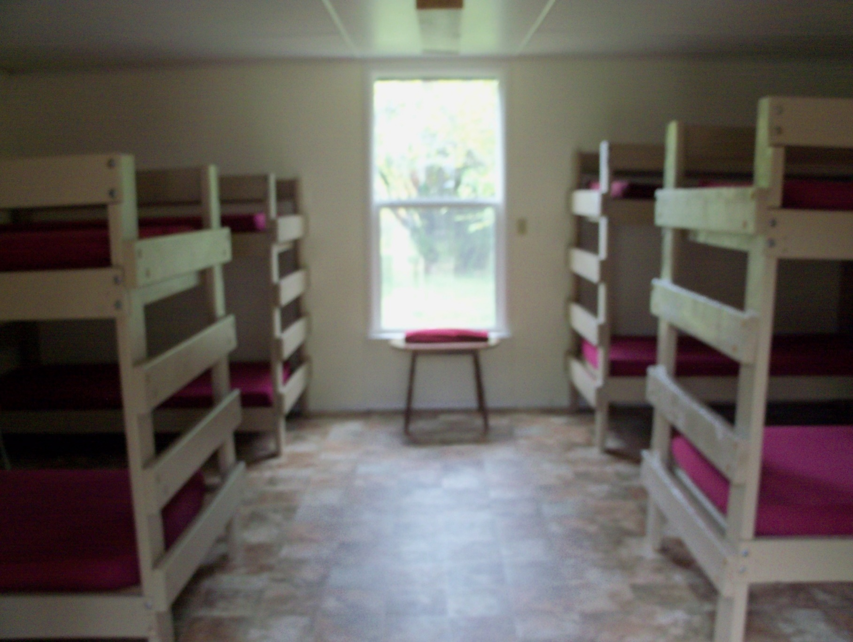
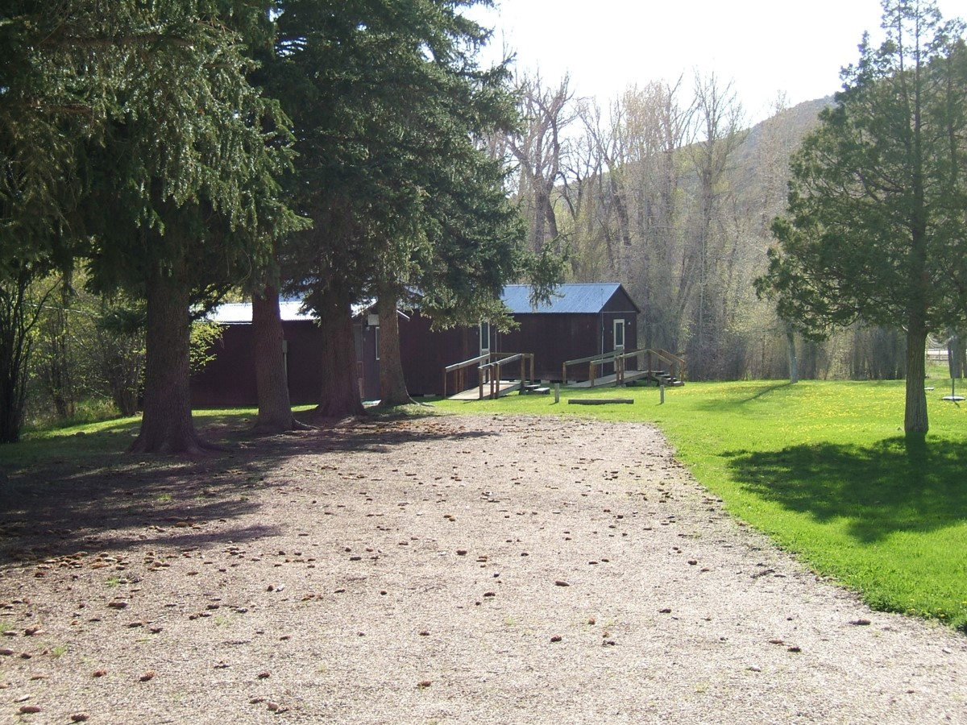
Our rustic cabins offer comfortable accommodations.
All you need to supply are the pillows and sleeping bags.
A Typical Cabin

Slide 4
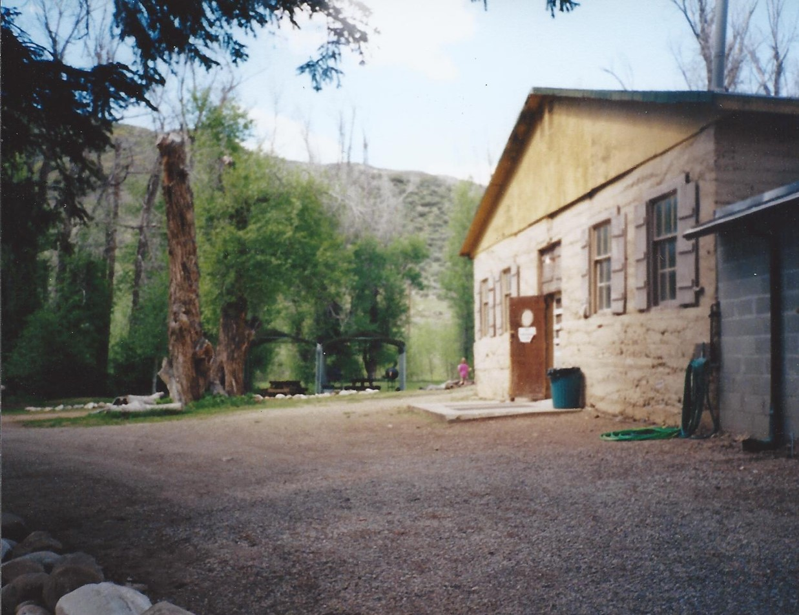
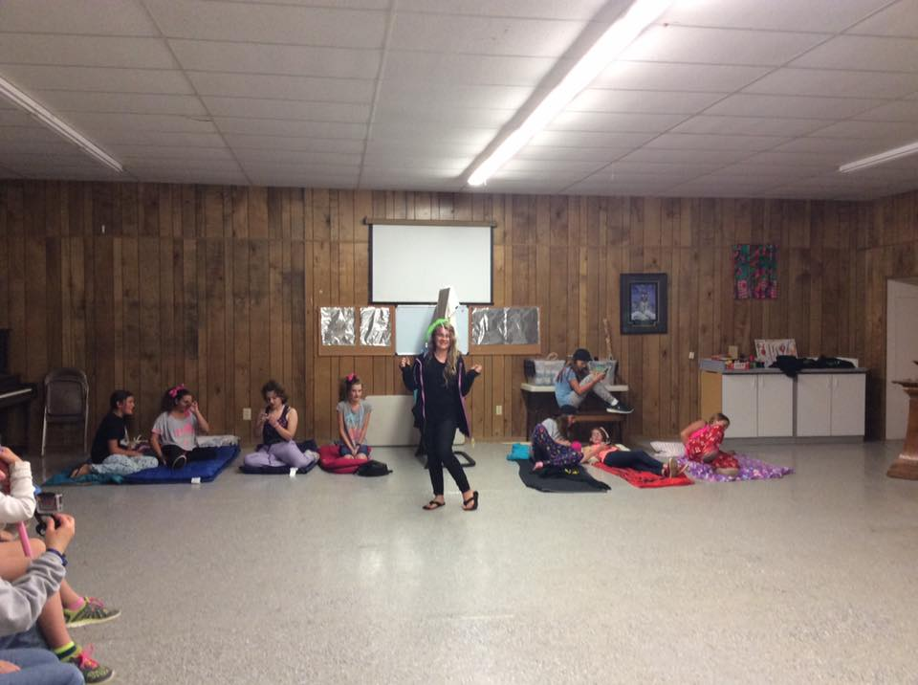
Our lodge contains a large area for meeting and dining.

Slide 5
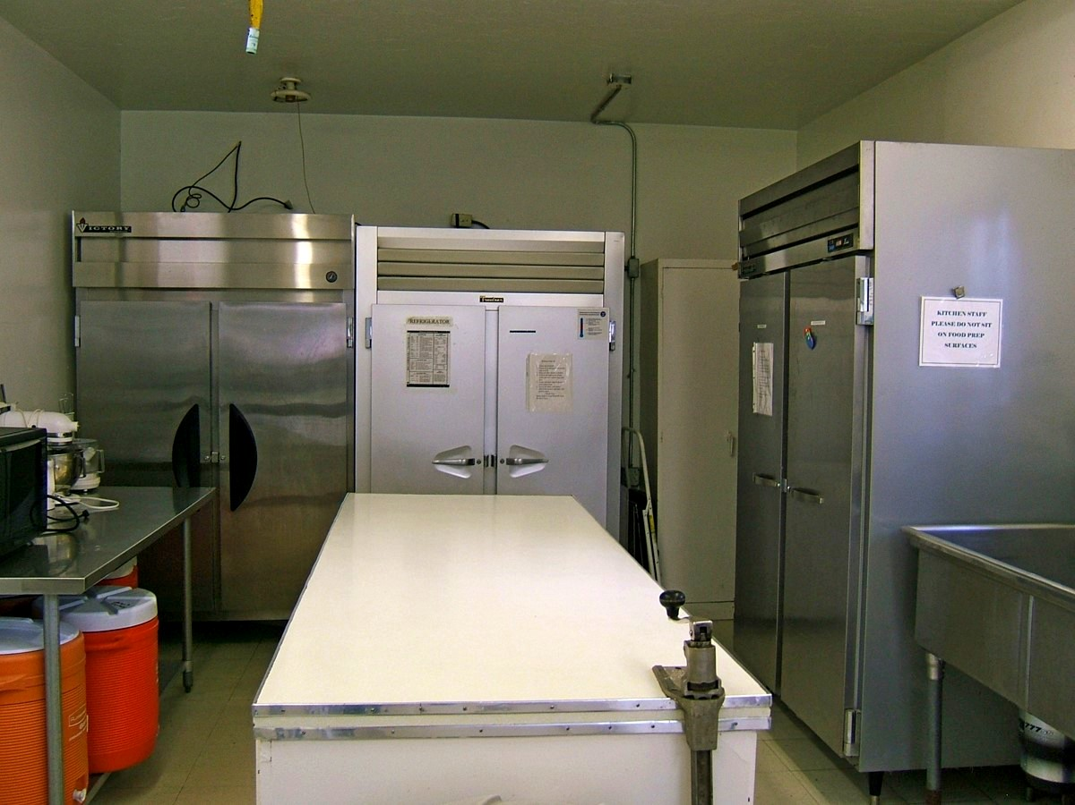
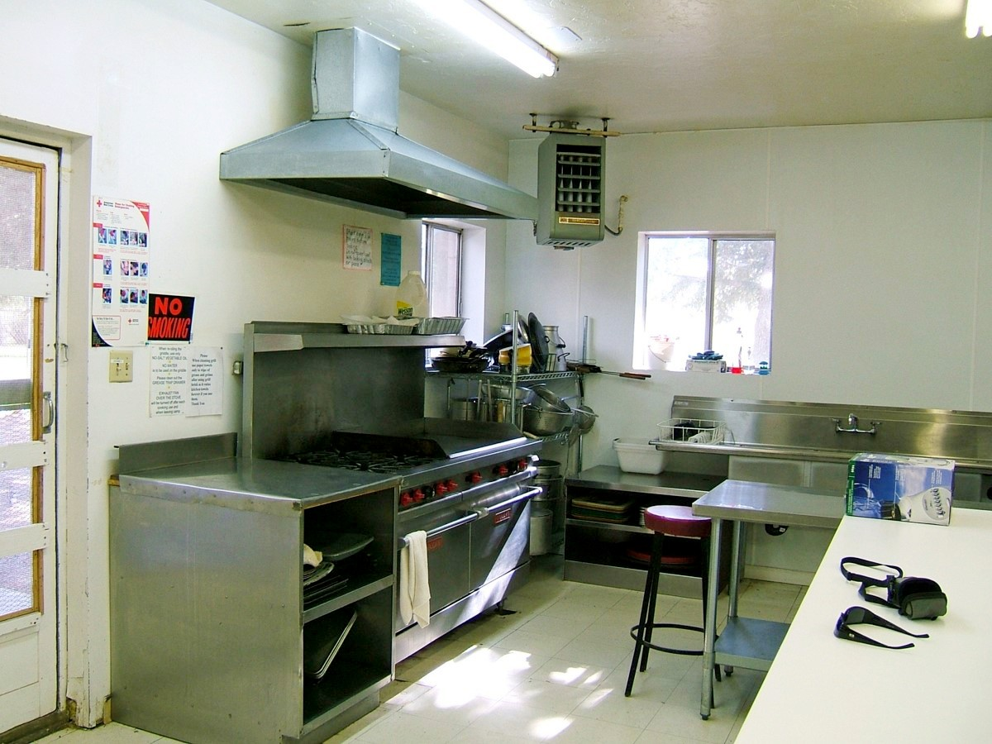
A large and fully equipped kitchen…
is available for your meal preparation and food storage.

Slide 6
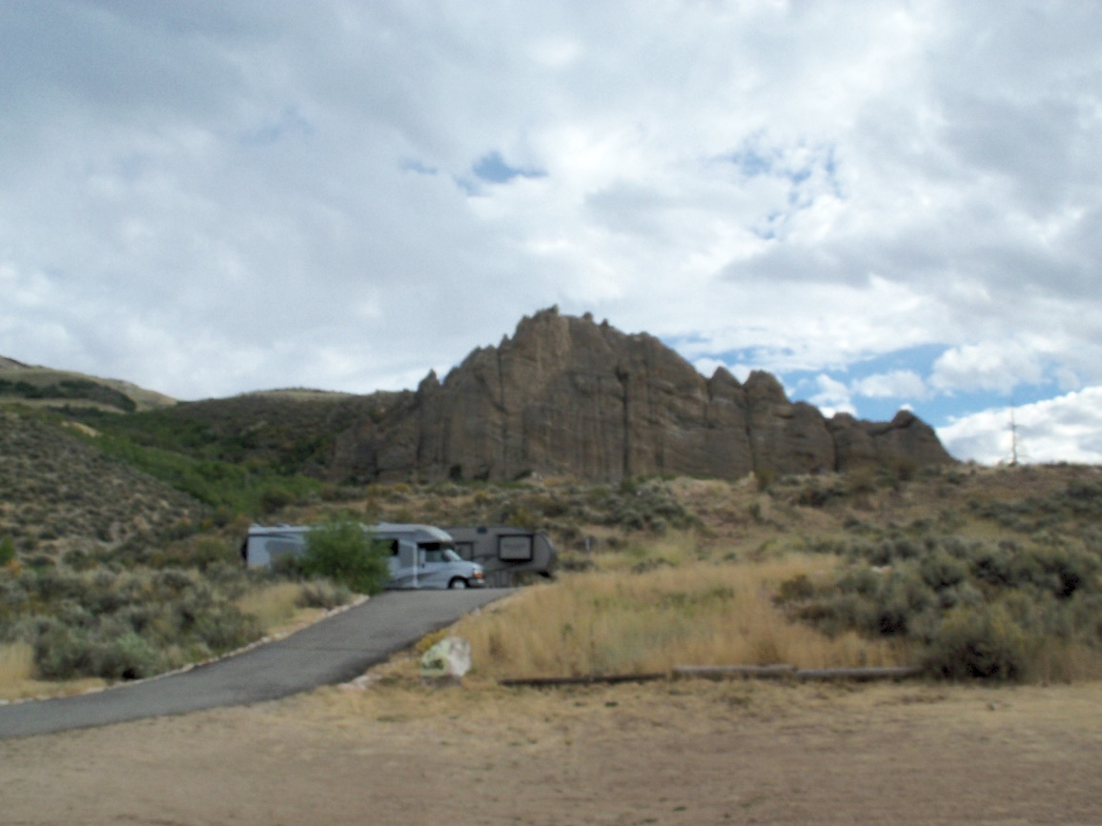
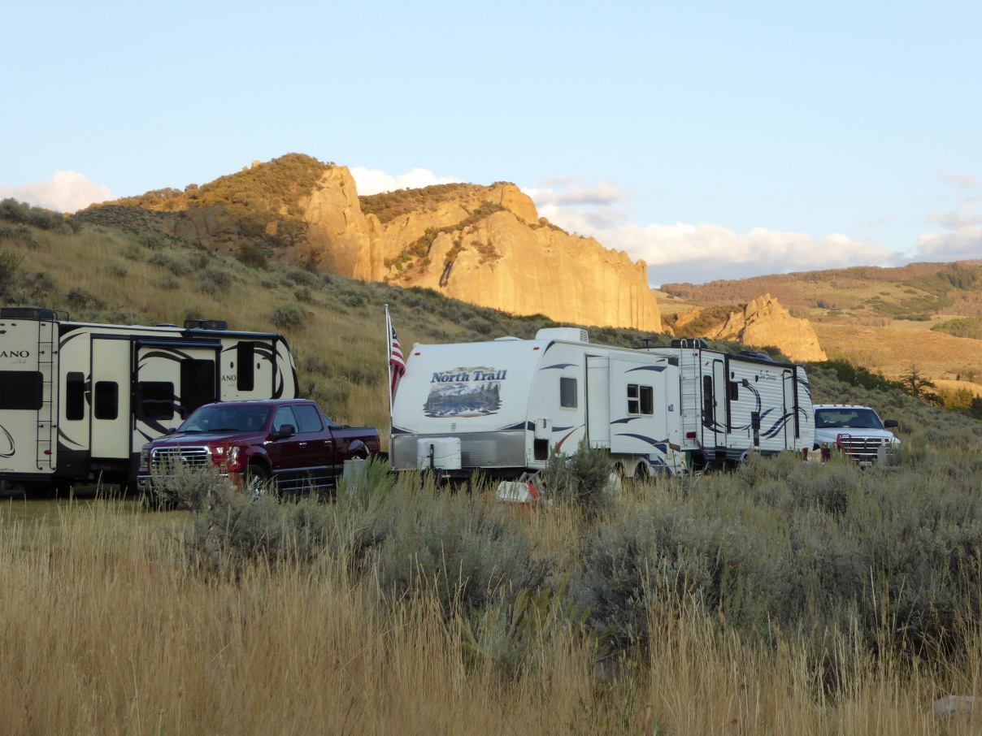
Our RV Park will accommodate up to six large rigs with 30/50A electric & water hook-ups.
A sewage dumping station is also available.

Slide 7
What better place for a worship experience…
than in our “Chapel by the Creek”.

Slide 8
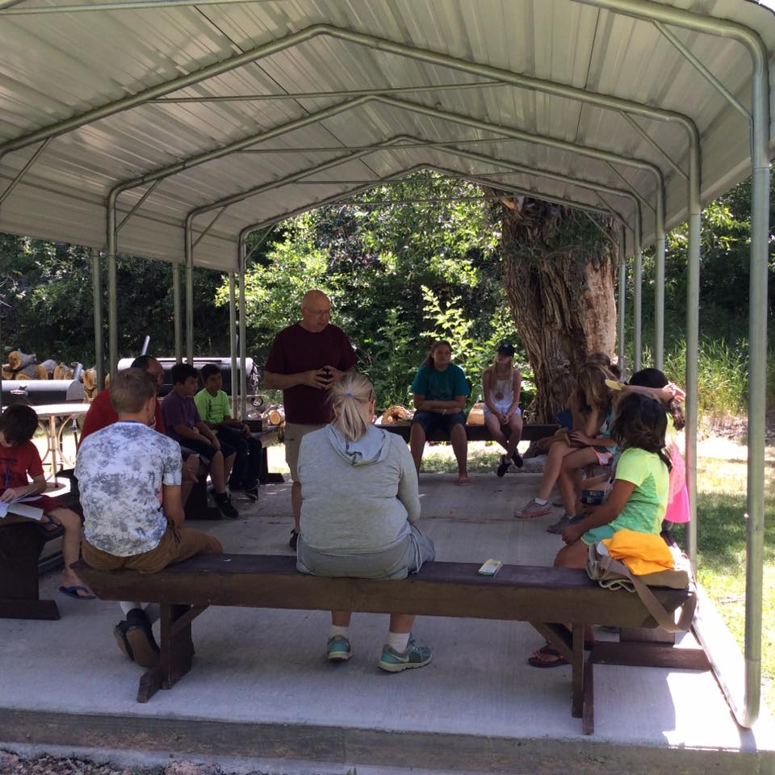
BIBLE STUDY
CAMP ACTIVITIES
CAMP ACTIVITIES

Slide 9
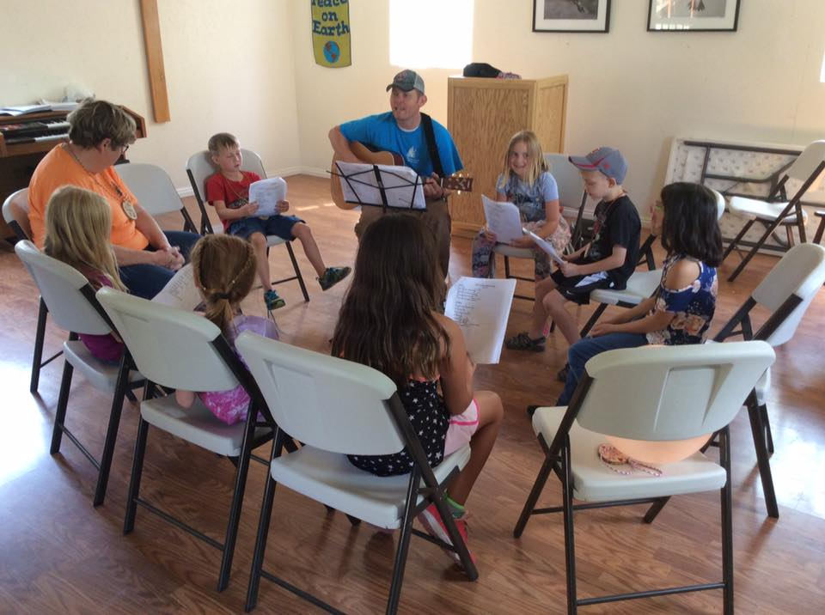
MUSIC TIME
CAMP ACTIVITIES
CAMP ACTIVITIES

Slide 10
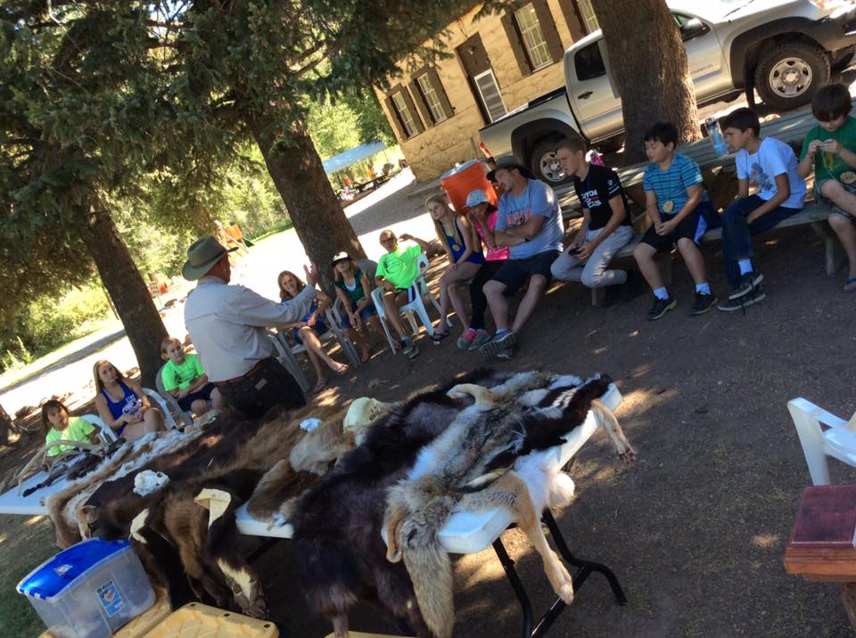
WILDLIFE PRESENTATION
CAMP ACTIVITIES
CAMP ACTIVITIES

Slide 11
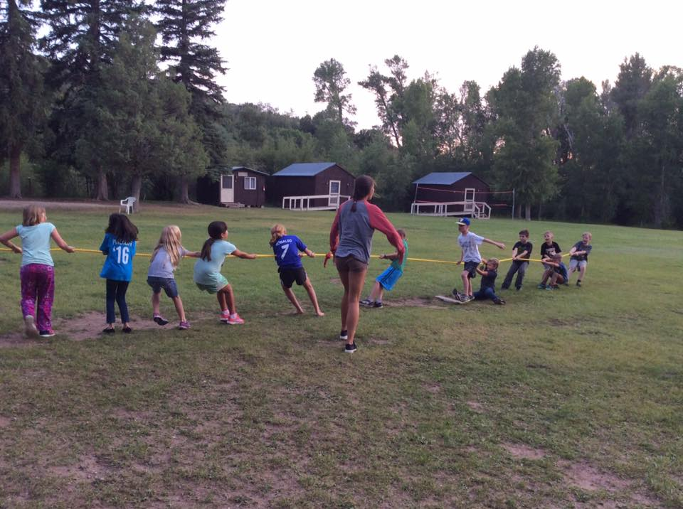
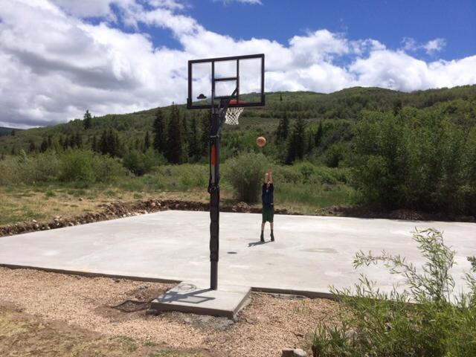
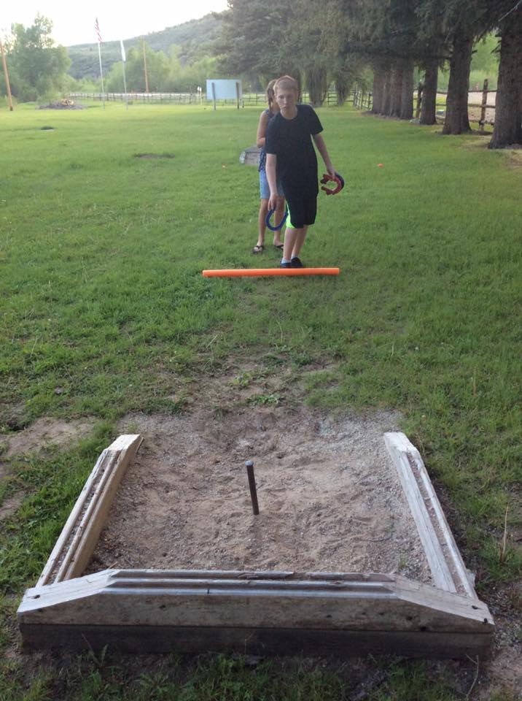
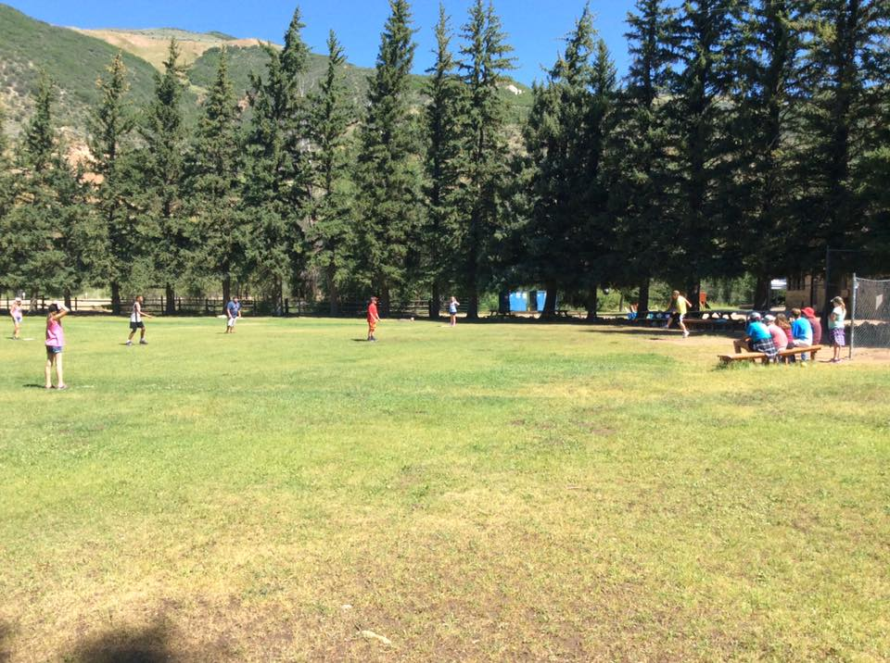
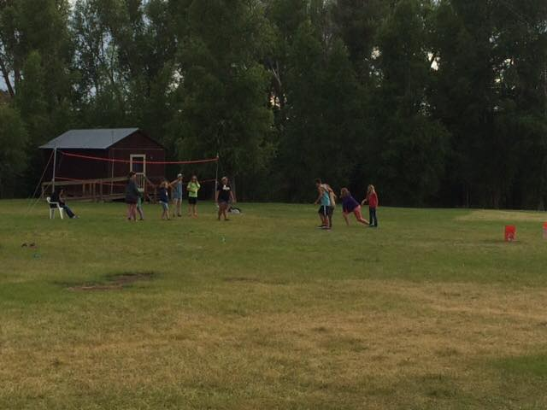
GAMES
CAMP ACTIVITIES
CAMP ACTIVITIES
Tug-Of-War
Basketball
Horseshoes
Volleyball
Softball

Slide 12
GAGA PIT
CAMP ACTIVITIES
CAMP ACTIVITIES
What is Gaga? It is a kinder gentler version of dodge ball. The game is played with a soft foam ball, and combines the skills of dodging, striking, running, and jumping, while trying to hit opponents with a ball below the knees.

Slide 13
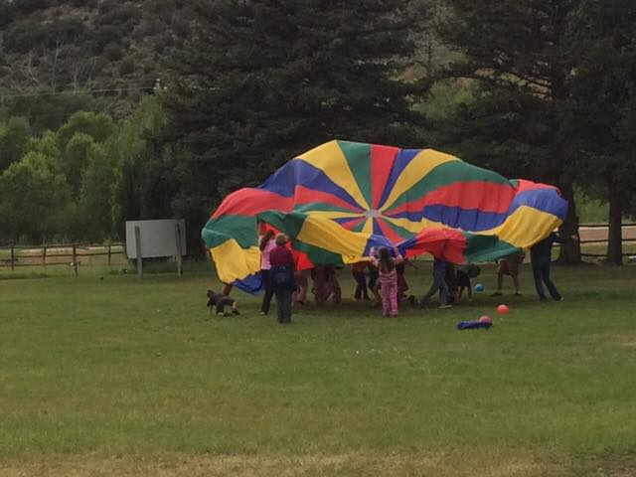
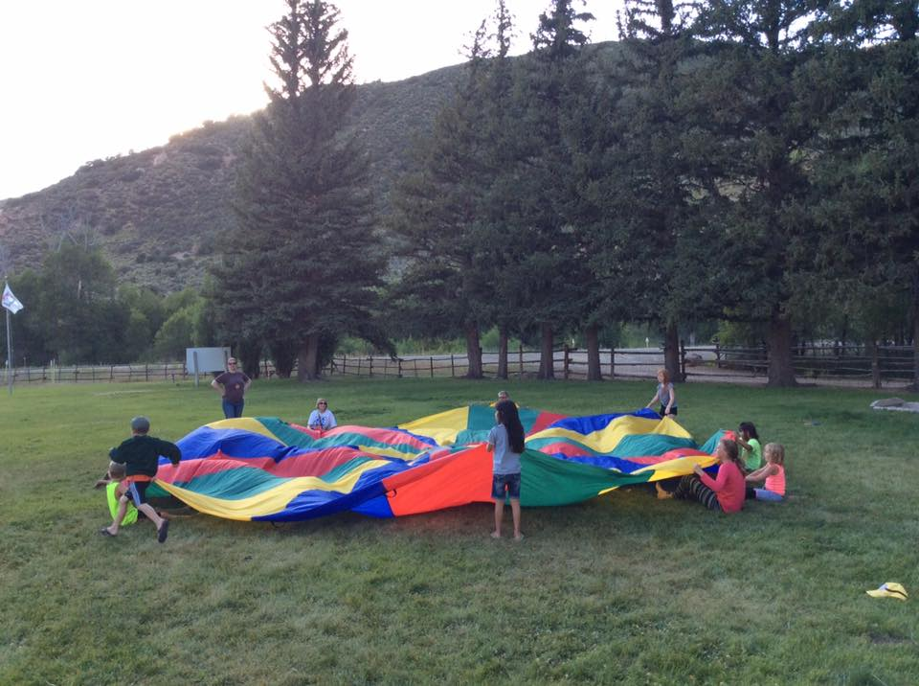
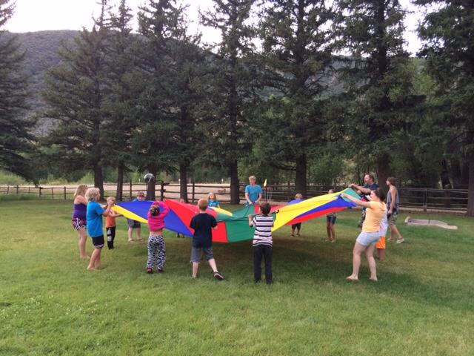
CAMP ACTIVITIES
CAMP ACTIVITIES
Playing with Parachute Fabric

Slide 14
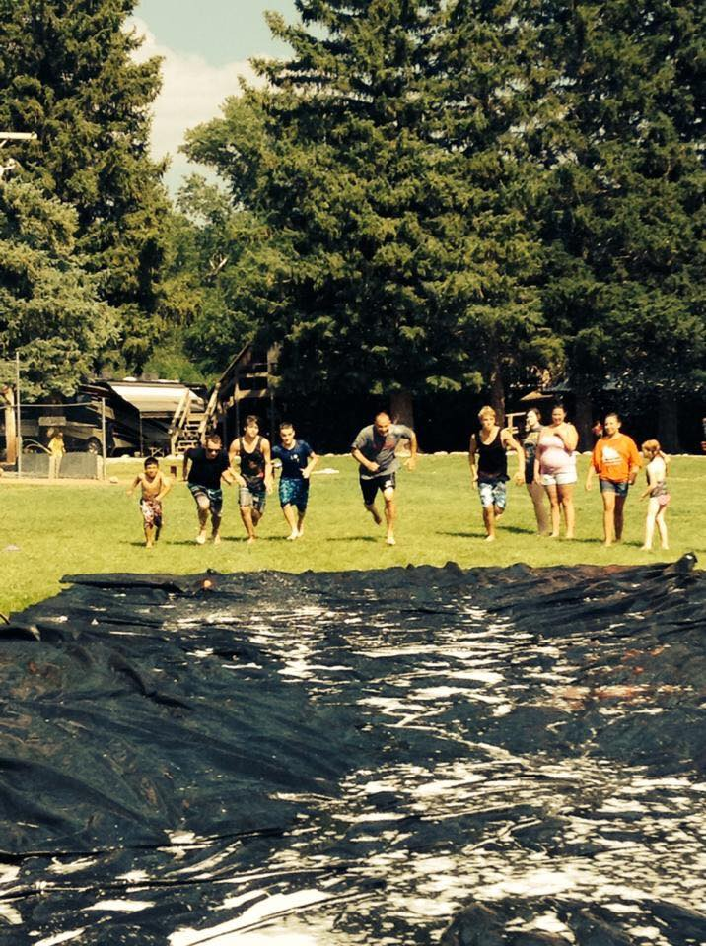
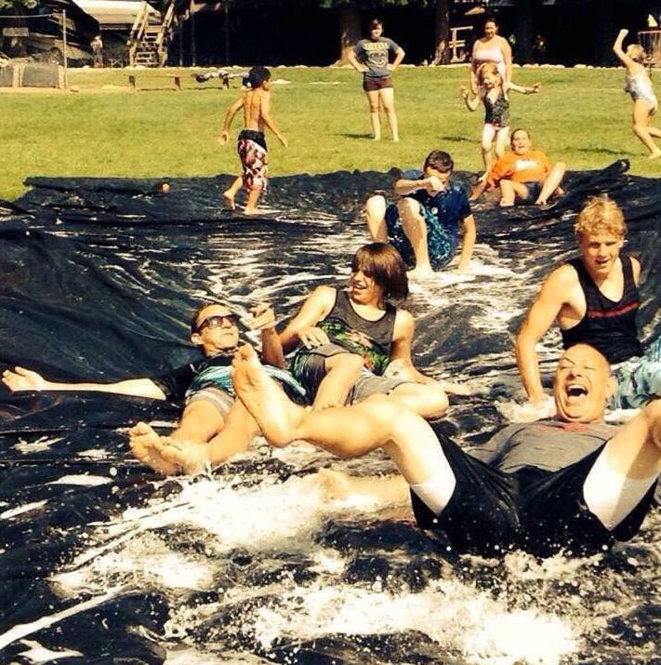
CAMP ACTIVITIES
CAMP ACTIVITIES
SLIP-N-SLIDE

Slide 15
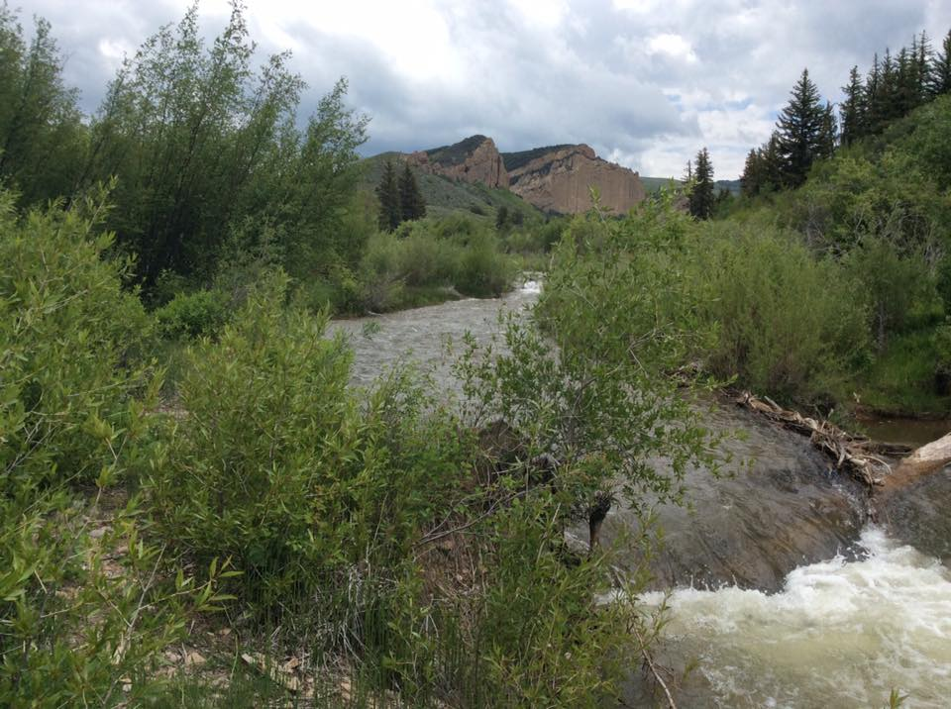
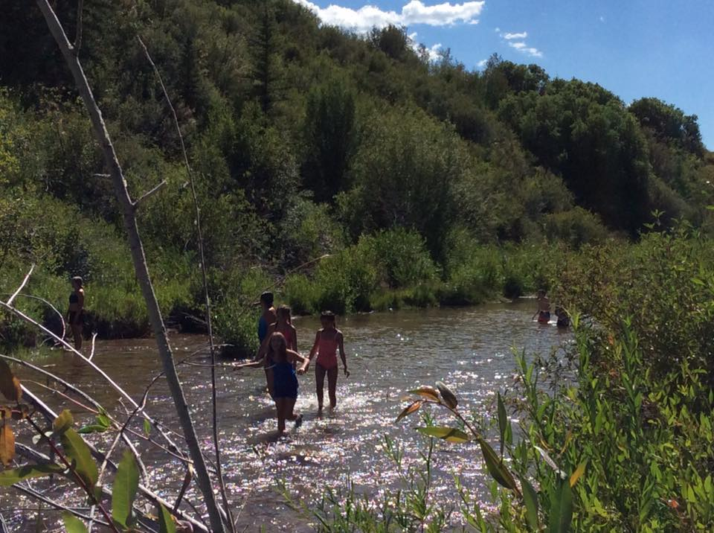
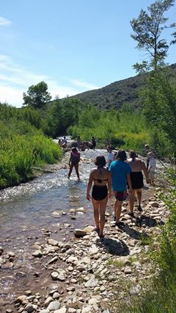
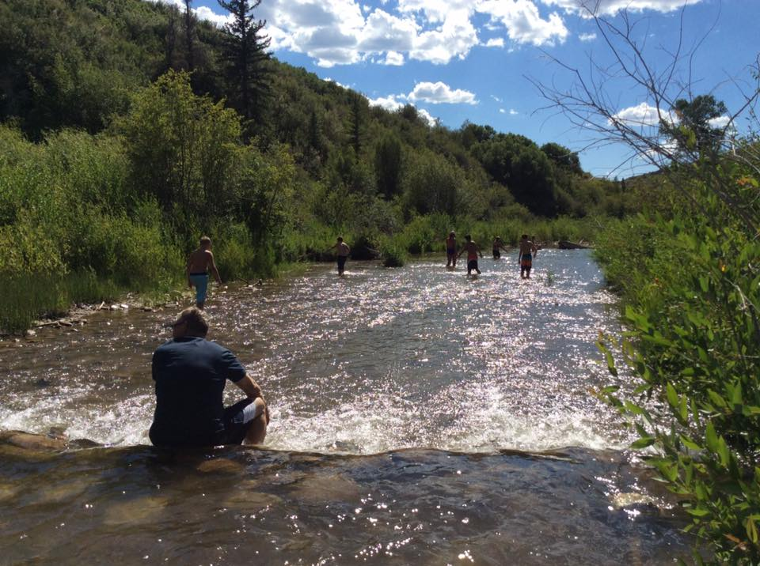
Fish, raft, or float in the serene waters of
Chalk Creek.
CAMP ACTIVITIES
CAMP ACTIVITIES

Slide 16
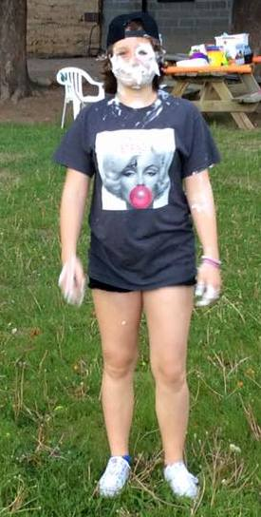
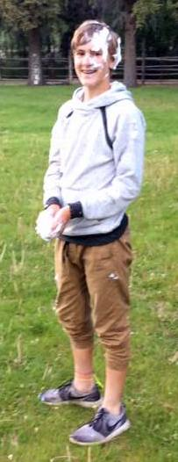
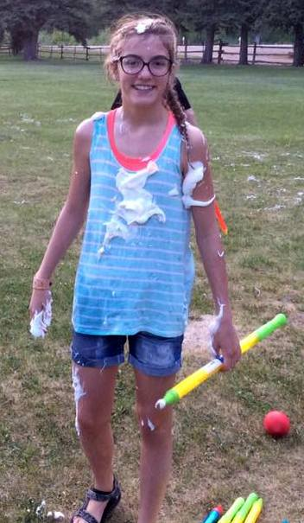
CAMP ACTIVITIES
CAMP ACTIVITIES
SHAVING CREAM BALOON FIGHT

Slide 17
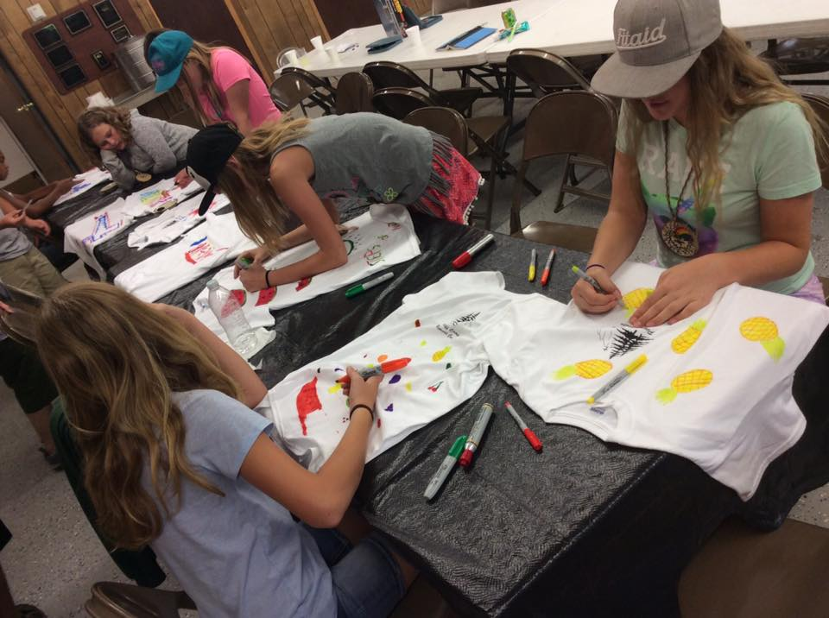
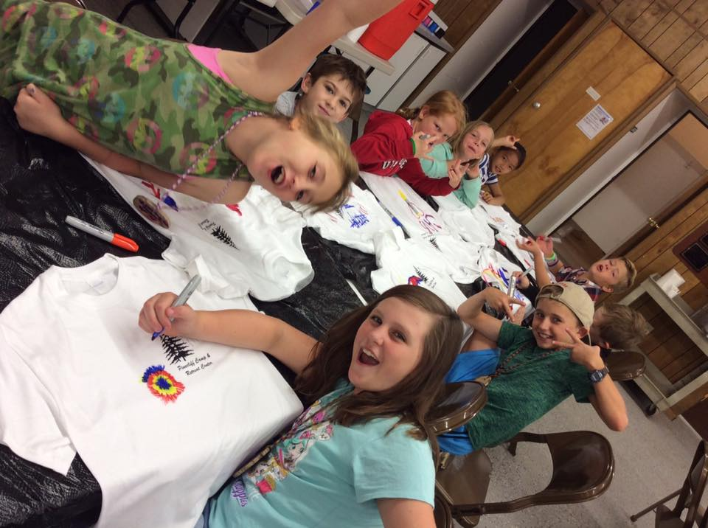
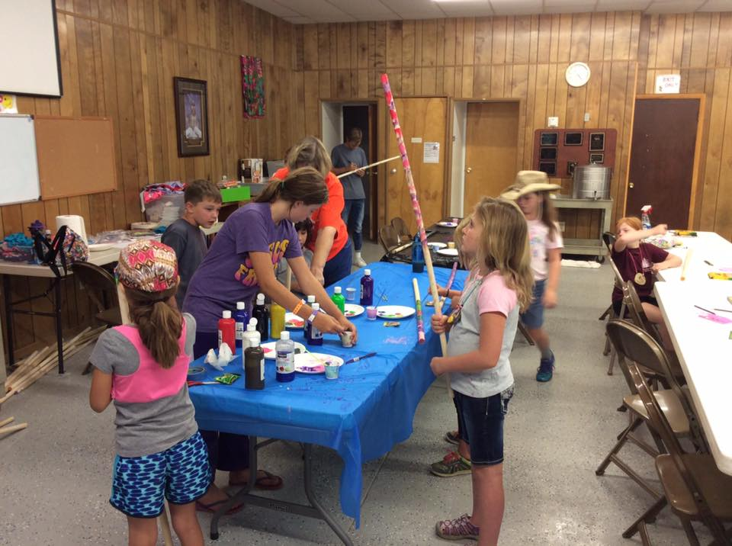
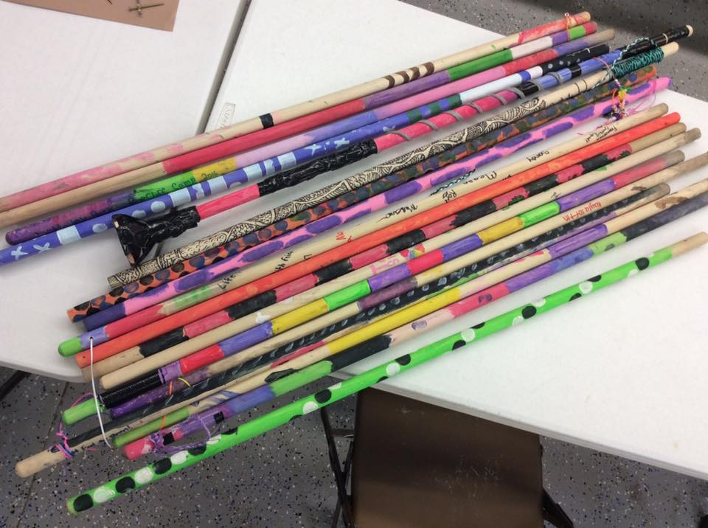
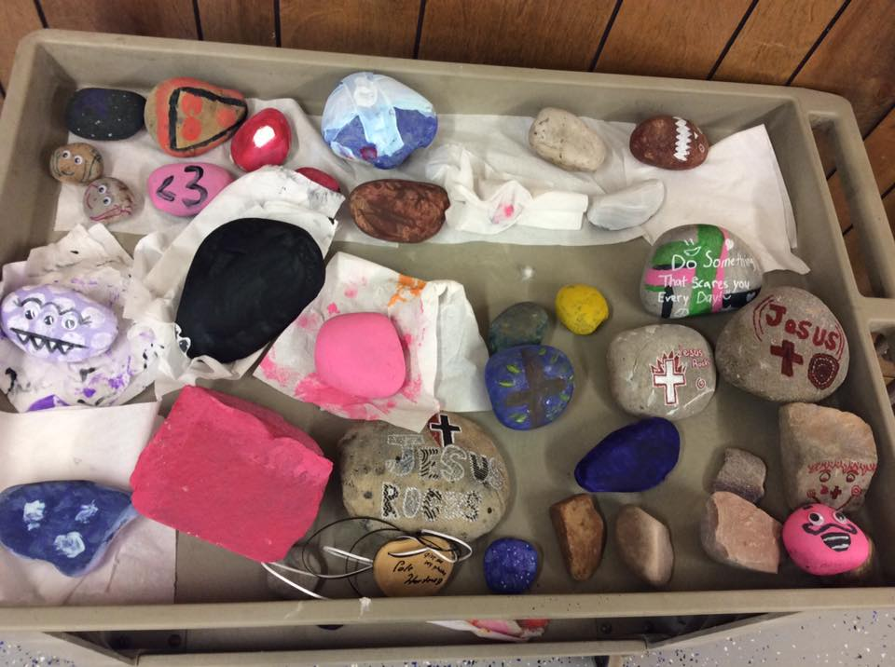
CAMP ACTIVITIES
CAMP ACTIVITIES
ARTS & CRAFTS

Slide 18
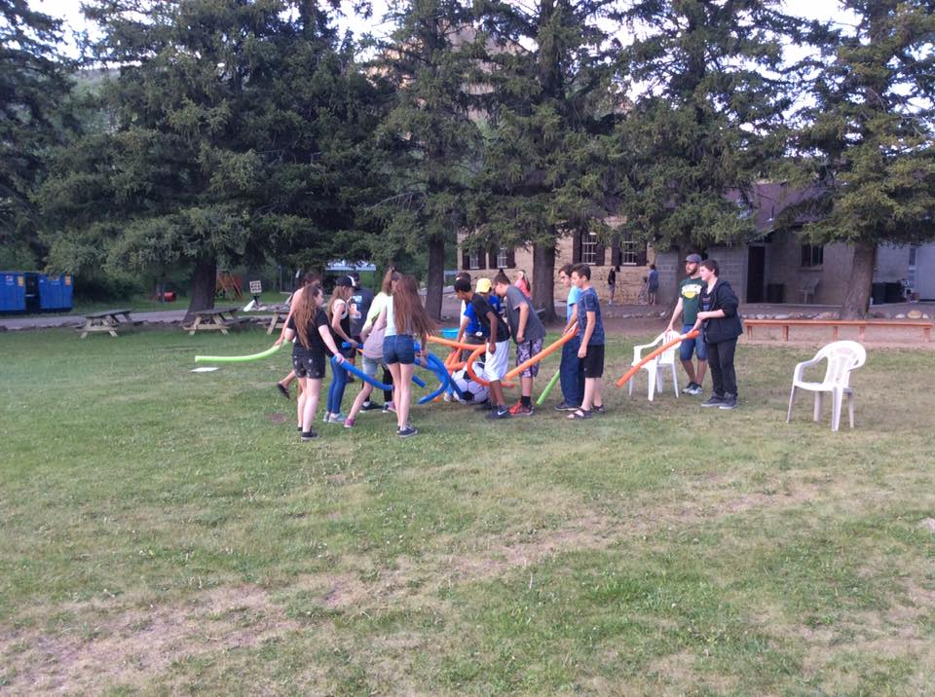
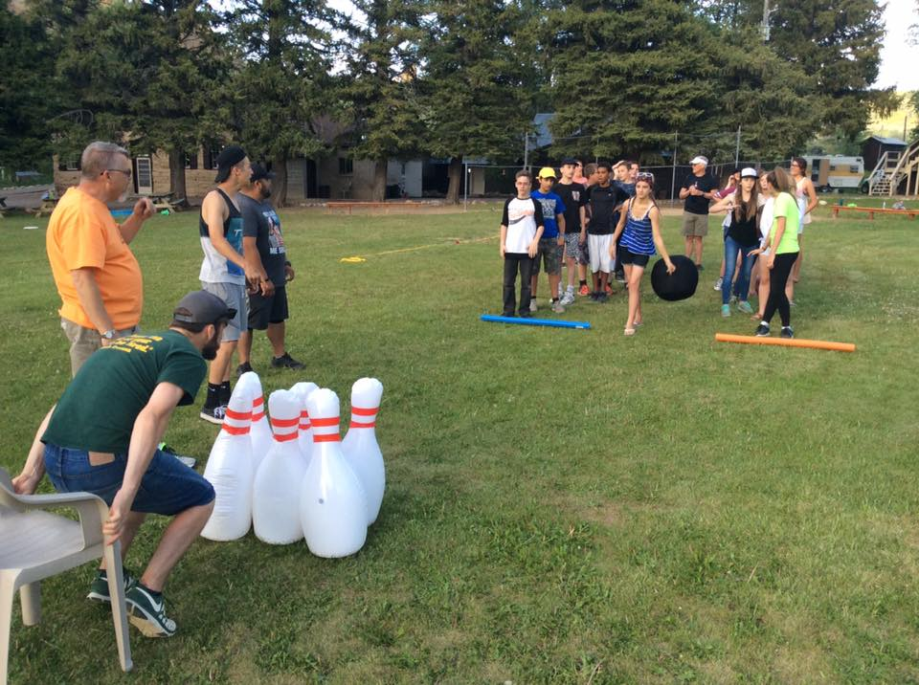
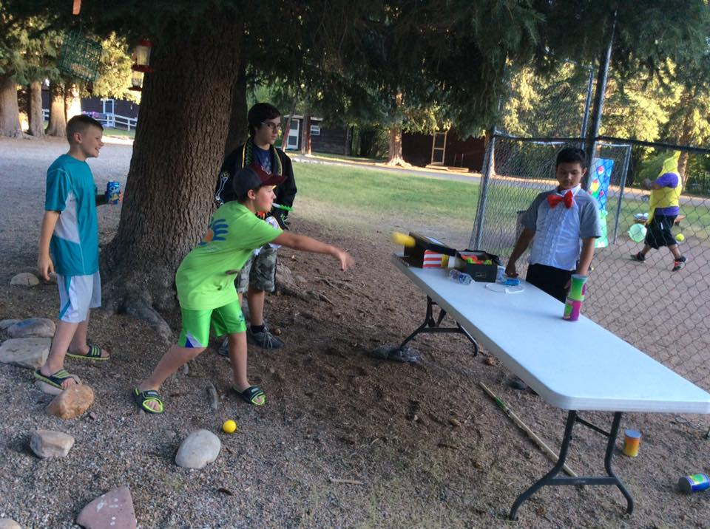
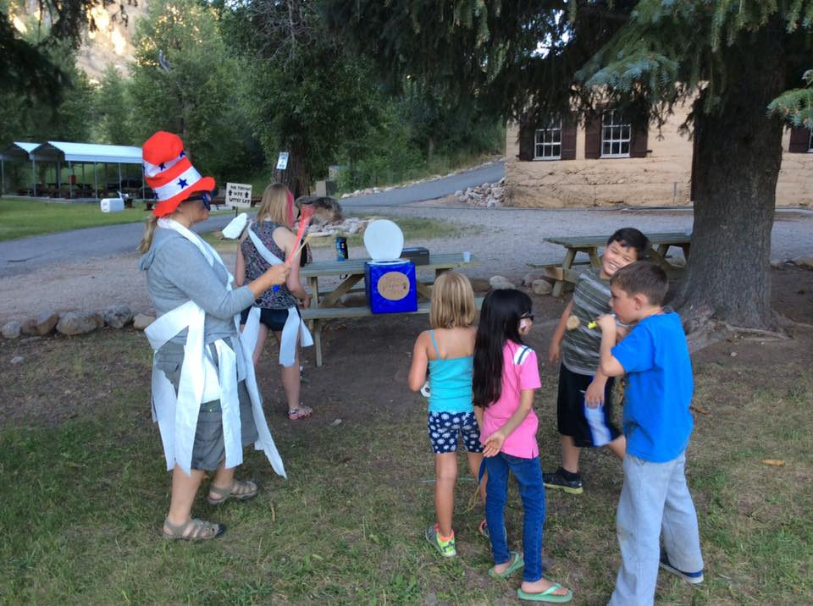
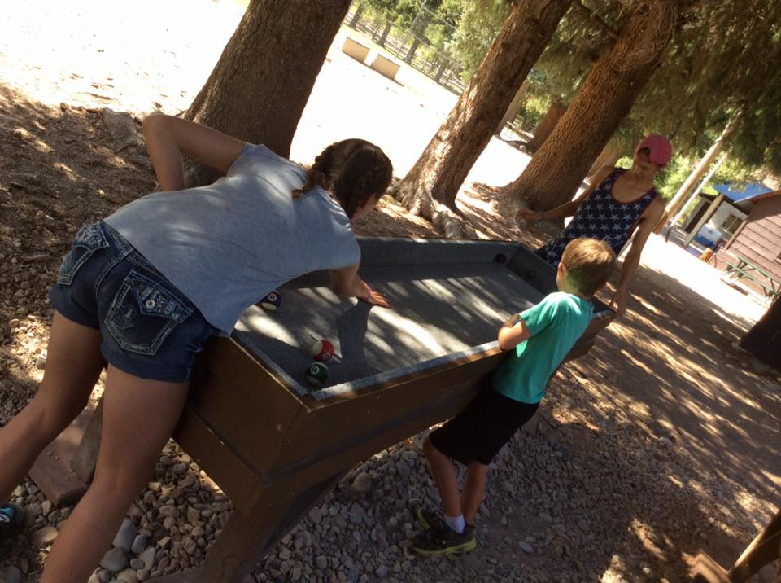
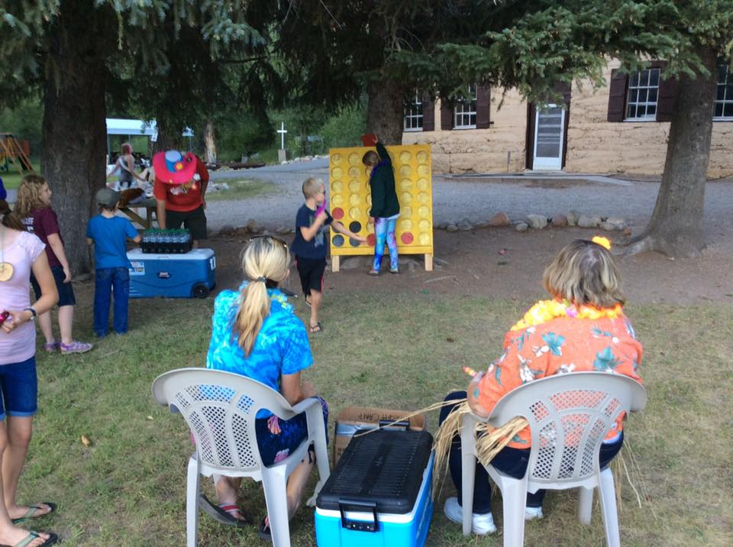
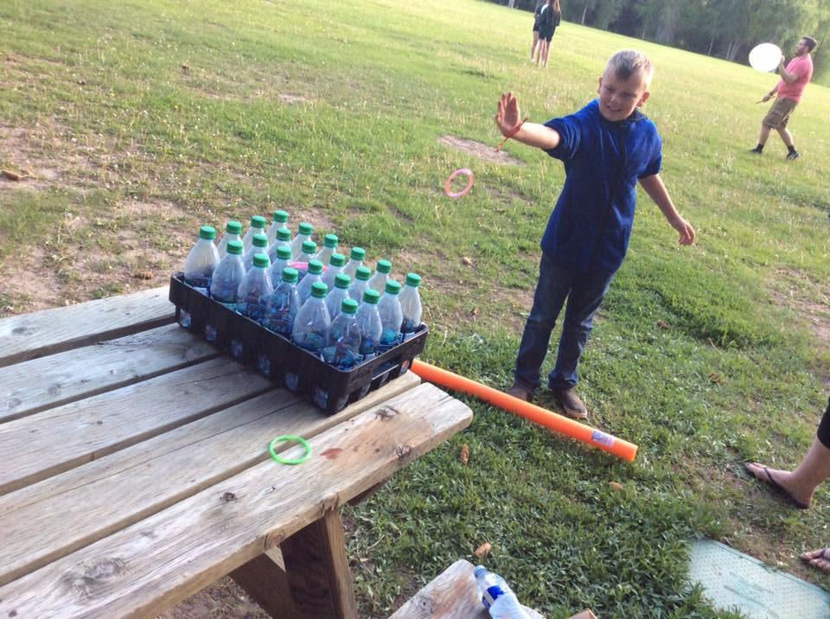
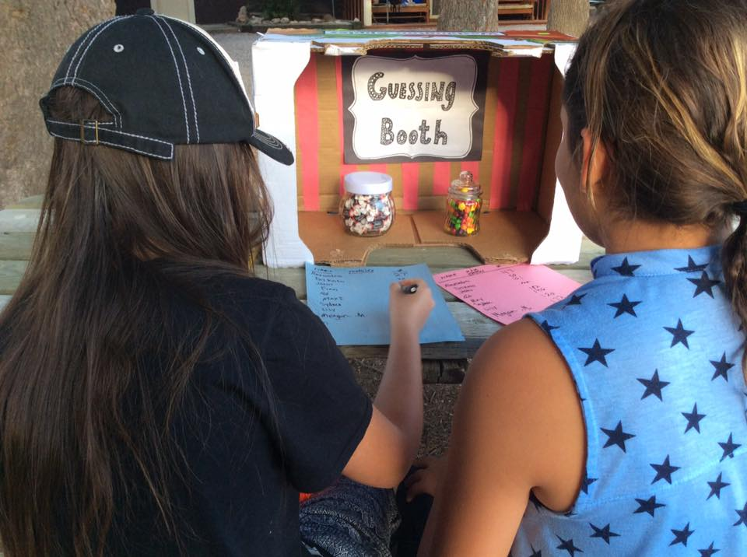
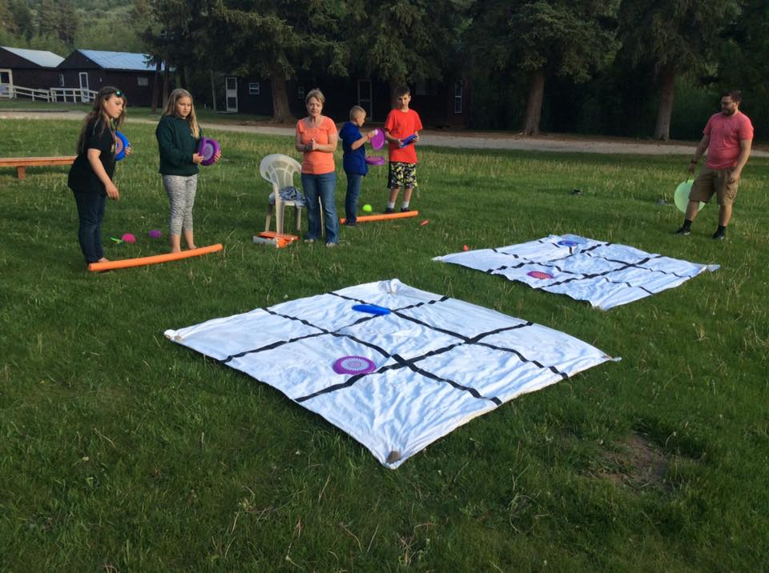
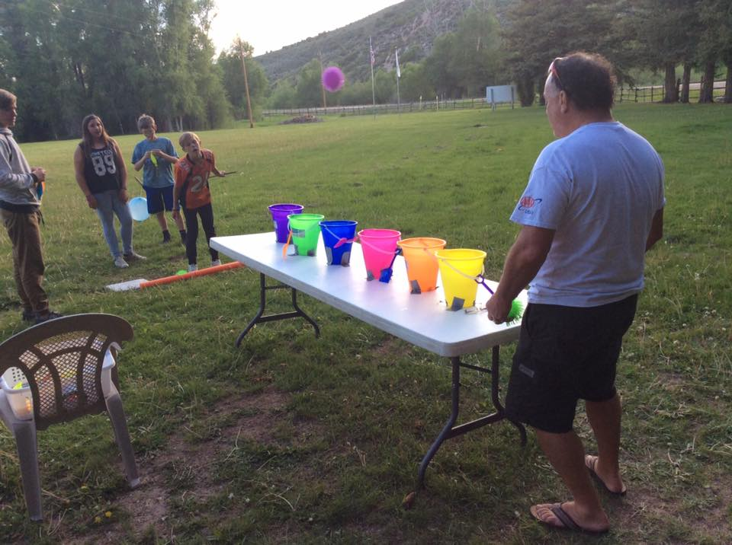
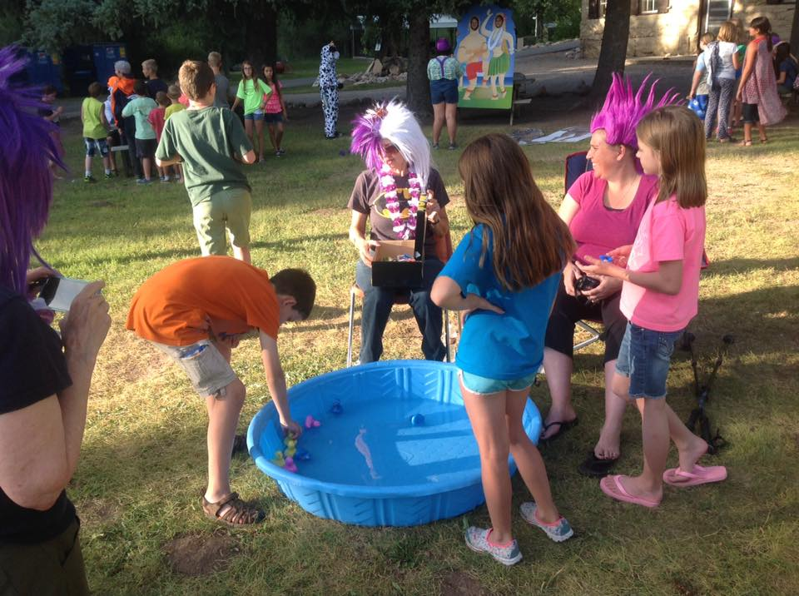
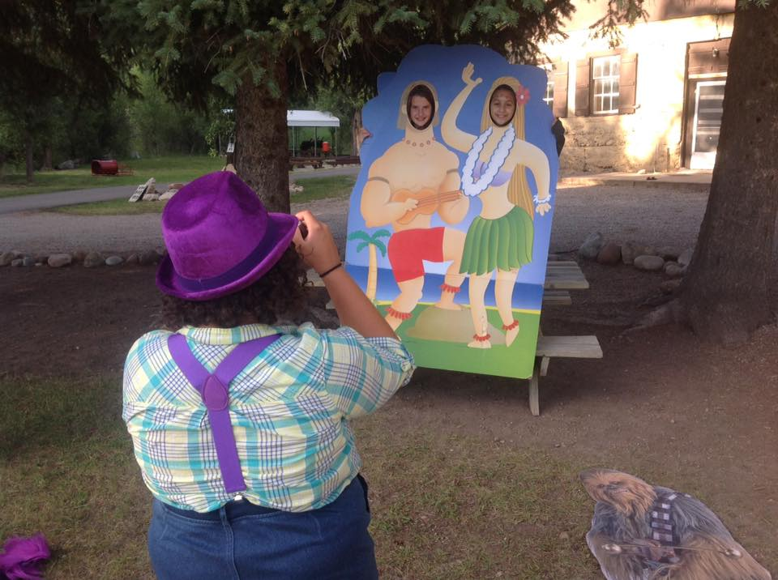
GAME NIGHT
CAMP ACTIVITIES
CAMP ACTIVITIES

Slide 19
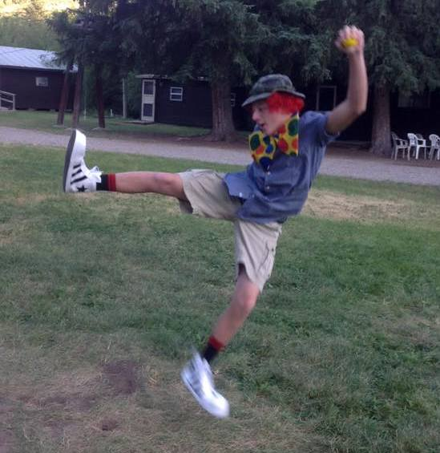
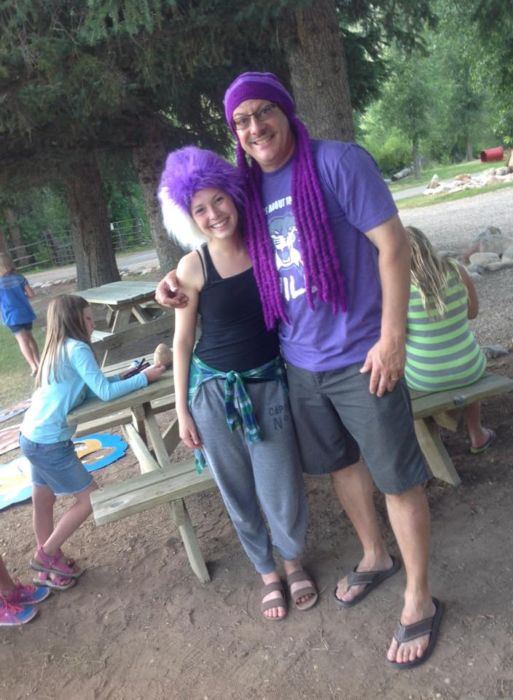
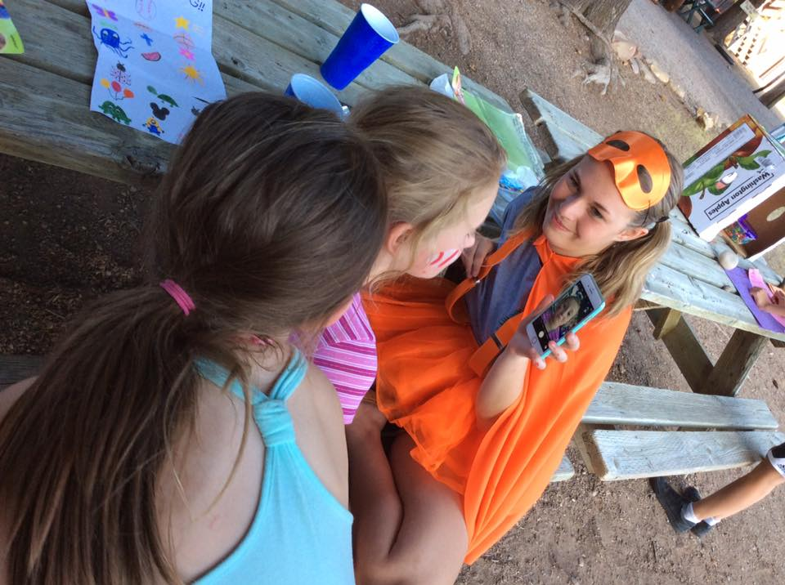
CARNIVAL
CAMP ACTIVITIES
CAMP ACTIVITIES
NIGHT

Slide 20
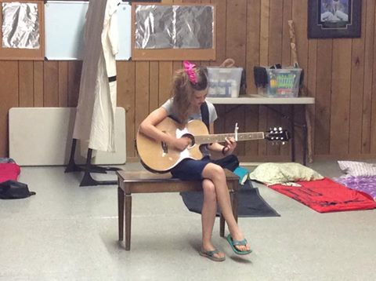
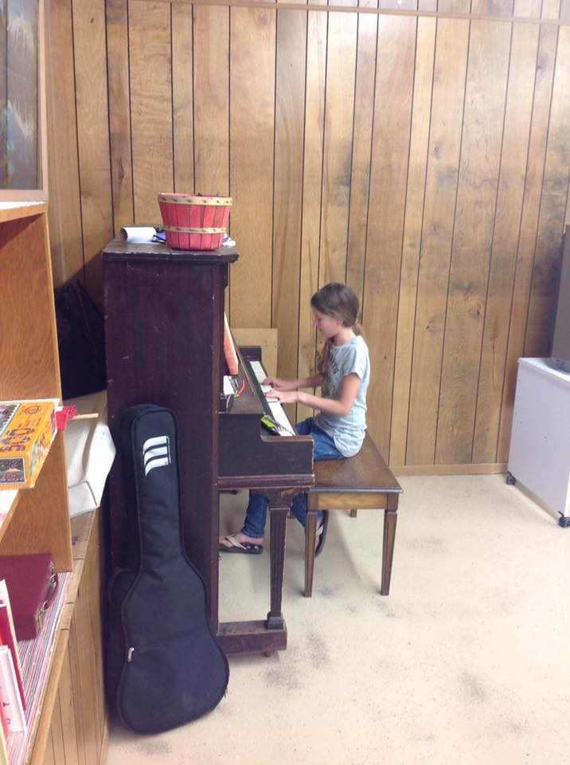
CAMP ACTIVITIES
CAMP ACTIVITIES
TALENT SHOW

Slide 21
CAMP ACTIVITIES
Hiking
CAMP ACTIVITIES

Slide 22
The high point of every Pinecliff experience is the
“Hike to the Cross.”

Slide 23
CAMP ACTIVITIES
SERVICE PROJECTS
CAMP ACTIVITIES

Slide 24
A Great Place for a sing-a-long by the campfire!
CAMP ACTIVITIES
CAMP ACTIVITIES
Does anyone want s’mores?

Slide 25
Lodge
Caretaker’s Residence
Store
Chapel
Dispensary
Pinecliff
Facilities
Bathhouse

Slide 26
No matter what the season,
Springtime,
Winter
Summer,
Fall, or
Pinecliff is always beautiful!

Slide 27
If you have one of these, you are part of the Pinecliff family and its history!

Slide 28
BECOME INVOLVED
SEND YOUR CHILD TO CAMP
RESERVE A SPOT FOR
GROUP OR FAMILY GATHERINGS
BECOME INVOLVED
JOIN US AT A WORK CAMP
DONATE YOUR TIME & RESOURCES

Slide 29
FOR FURTHER IMFORMATION
Contact
PinecliffCampUtah@gmail.com
Susan Wagner 801-775-0658 or Paul Allison 801-278-9223
www.PinecliffCampUtah.org
PINECLIFF CAMP
PINECLIFF CAMP
“God changes caterpillars into butterflies, sand into pearls, and coal into diamonds using time and pressure. He’s working on you too.” - Rick Warren

